Slide 1
WIDA English Language Development Standards Framework, 2020 Edition: Kindergarten – Grade 12
PowerPoint slides to share with colleagues and stakeholders
Updated December 2020
Notes:
This PowerPoint slide deck is designed to share information with colleagues and stakeholders. You may customize these slides to meet your needs. Relevant talking points are added to the notes section of each slide.

Slide 2
WIDA ELD Standards Framework, 2020 Edition
Kindergarten – Grade 12
Notes:
The WIDA ELD Standards, 2020 Edition:
Builds on ideas and concepts from existing resources and prior editions
Advances the latest theory, policy and practice
Incorporates ideas and feedback from educators around the world
Designed with meeting all federal requirements under ESSA in mind
Serves as the foundation for systems that foster students’ engaged interactive learning and collaborative educator practice

Slide 3
Organization of the 2020 Edition
Notes:
The 2020 Edition presents a new supporting organization for the WIDA ELD standard statements, along with additional resources .

Slide 4
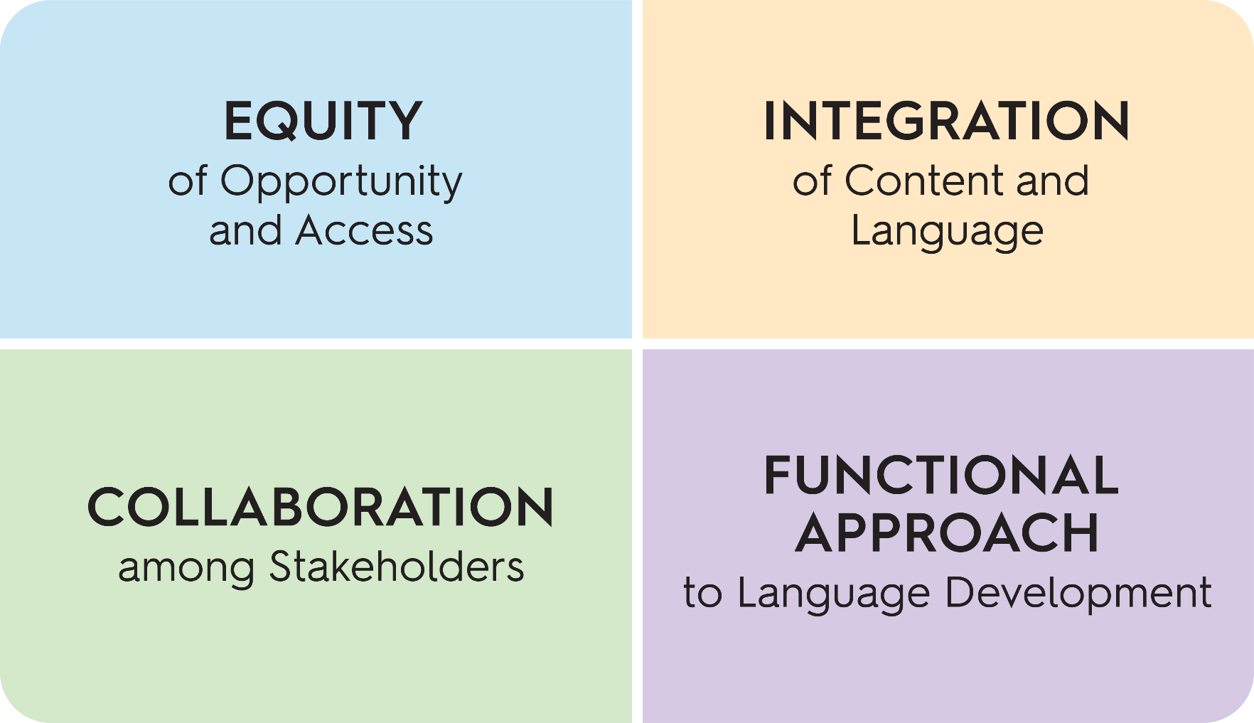
What are the Big Ideas for 2020?
Notes:
These four Big Ideas anchor the standards and are interwoven throughout the document:
equity of opportunity and access
integration of content and language
collaboration among stakeholders
functional approach to language development

Slide 5
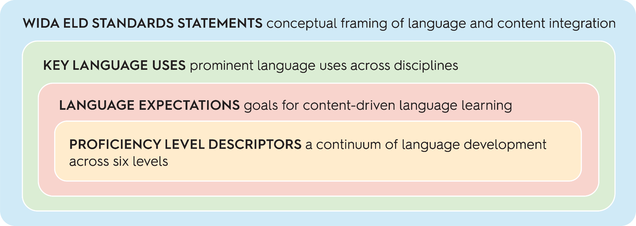
The WIDA ELD Standards Framework
Notes:
The WIDA ELD Standards Framework consists of four components, ranging from broad to narrow in scope: WIDA ELD Standards Statements, Key Language Uses, Language Expectations, Proficiency Level Descriptors.
They work together to make a comprehensive picture of language development. This figure shows the four components of the framework conceptualized as nested building blocks of language development within sociocultural contexts.

Slide 6
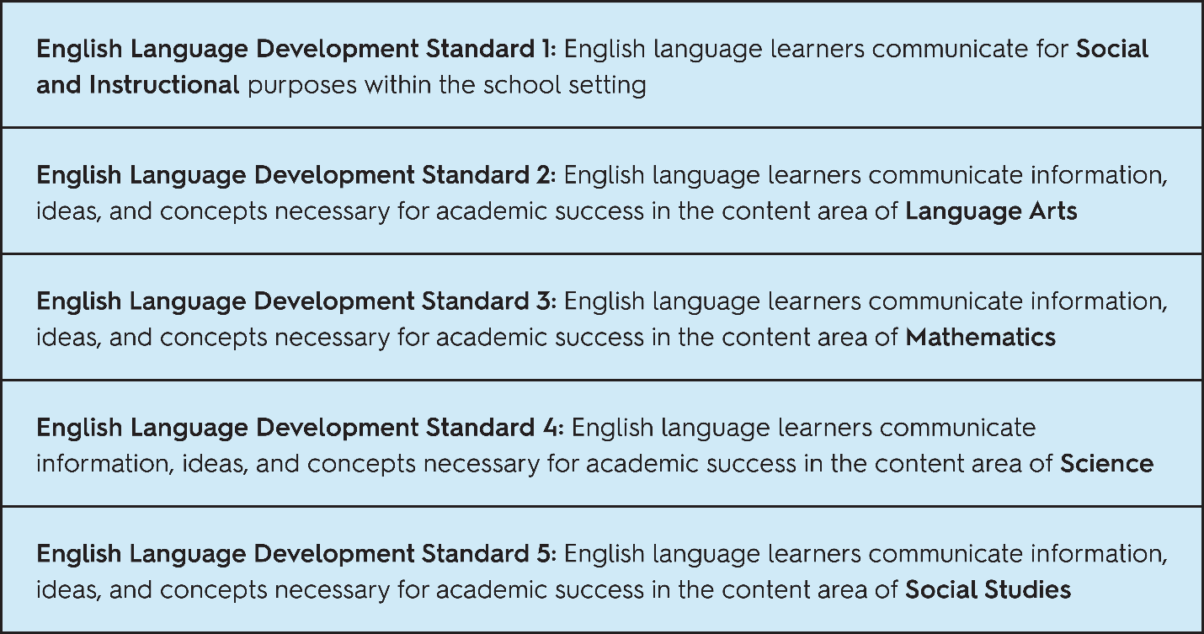
WIDA ELD Standards Statements
Can Do Philosophy
.
Notes:
The 5 English Language Development Standards remain as the foundation to our system. They are staying the same.
They provide the broadest conceptual framing and illustrate the integration of content and language.
The standards statements show language use in the service of learning—in other words, language for thinking and doing. They address the language of schooling.

Slide 7
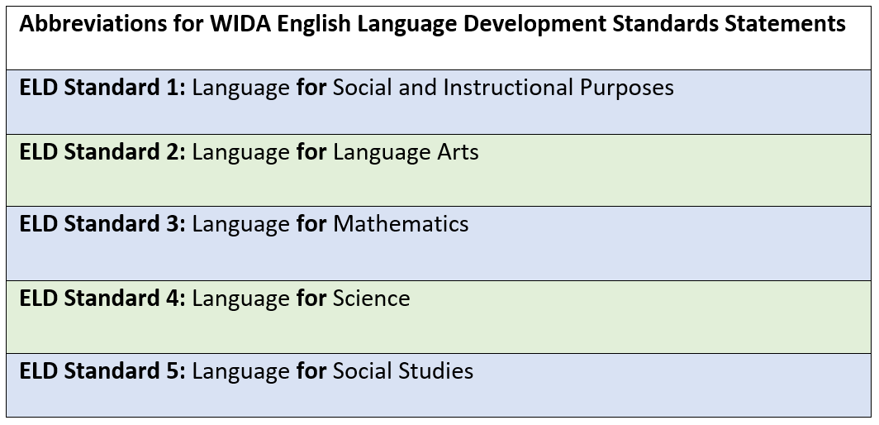
Abbreviations for the Five Original WIDA ELD Standards Statements

Slide 8
Key Language Uses
KLUs:
Select genre families that appear across academic content standards.
Notes:
Key Language Uses (KLUs) are select genre families that appear across content areas: Narrate, Inform, Explain, Argue.
KLUs summarize prominent language across disciplines, helping educators organize and coordinate instruction.

Slide 9
Language Expectations
Language Expectations are goals for content-driven language learning.
Notes:
Language Expectations are goals for content-driven language instruction, adding specificity to the ELD standards statements and Key Language Uses. They are the statements most similar to what educators generally find in academic content standards.

Slide 10
Proficiency Level Descriptors
​
PLDs:
Describe student language development for activities that target WIDA Language Expectations.
Notes:
Proficiency Level Descriptors (PLDs) are a detailed articulation of student language performance across six levels of English language proficiency.
Each end-of-level descriptor includes and builds on previous levels (e.g., PL4 = PL1 + PL2 + PL3 + PL4).
PLDs are aligned to the six grade-level clusters used in ACCESS online (K, 1, 2-3, 4-5, 6-8, 9-12)

Slide 11
Materials are Organized into Six Grade-Level Clusters Corresponding to ACCESS for ELLs Online
Notes:
WIDA recognizes that English language development occurs over multiple years, is variable, and depends on many factors, such as multilingual learners’ ages, maturation, classroom experiences, motivation, attitudes, and types of educational programming.
With this in mind, we have developed sets of materials that are appropriate for students in different grade-level clusters (K, 1, 2-3, 4-5, 6-8, and 9-12).Within each grade-level cluster section, the materials are organized according to the components of the WIDA ELD Standards Framework and include some additional resources. The grade-level cluster materials help educators enact the WIDA ELD Standards Framework.
The grade-level clusters for the 2020 Edition match the grade-level clusters currently in use on ACCESS for ELLs Online.

Slide 12
Supplemental Resources
Annotated Language Samples
Key Language Uses: A Closer Look
Collaborative Planning for Content and Language Integration: A Jump-Off Point for Curricular Conversations
Notes:
Annotated Language Samples illustrate the WIDA ELD Standards Framework in authentic grade-level texts
Key Language Uses: A Closer Look—extended definitions and examples for each Key Language Use
Collaborative Planning for Content and Language Integration: A Jump-Off Point for Curricular Conversations

Slide 13
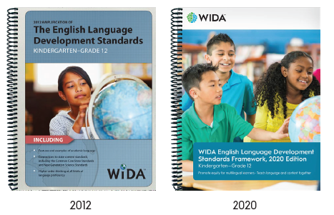
From 2012 to the 2020 Edition
What is staying the same?
The Can Do Philosophy, emphasizing the assets and potential of multilingual learners
WIDA ELD standards statements
Six levels of language proficiency
Six grade-level clusters
Notes:
Since its inception in 2003, WIDA’s Can Do Philosophy has been its mantra and has underscored its four editions of English language development standards—released in 2004, 2007, 2012, and 2020.
The editions of the standards have evolved over time to remain current with research, theory, policy, practice, and the demands of academic content standards.
Even as editions continue to evolve, throughout the years WIDA has remained steadfast in its commitment to equitable educational opportunities for multilingual learners as exemplified in its standards’ documents and resources.

Slide 14
From 2012 to the 2020 Edition
What is updated or new?
The WIDA ELD Standards Framework: reorganized into four components
More inclusive modes of communication: interpretive and expressive
Grade-Level Cluster Materials:
Language Expectations, Language Functions, and Language Features
Proficiency Level Descriptors
Annotated Language Samples
A jump-off point for curricular conversations: sample collaborative planning process for content language integration

Slide 15
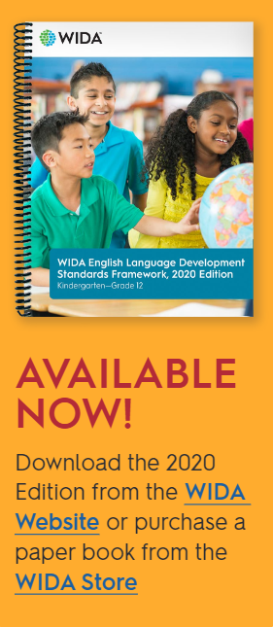
Educator next steps
Download the WIDA Guiding Principles of Language Development
Explore WIDA’s foundational beliefs about language development and supporting research.
Advocate for multilingual learners and put the Can Do Philosophy into action.
Get the 2020 Edition and refer to resources on the WIDA website
Download the PDF from the WIDA Website or purchase a book from the WIDA Store.
Access resources such as an introduction video, flyer, FAQs, focus bulletins, and more!
Learn about the ELD Standards Framework, 2020 Edition with WIDA Professional Learning
Join the Q&A Webinar Series, to learn about features and ask question about the 2020 Edition. Starting January 2021.
Learn about WIDA Professional Learning opportunities available starting February 2021. Registration for the WIDA Virtual Institute is currently open.
Notes:
Key web pages and links:
WIDA Guiding Principles of Language Development illustrated booklet: https://wida.wisc.edu/sites/default/files/resource/Illustrated-Guiding-Principles.pdf
WIDA ELD web page for the 2020 Edition PDF and supporting resources: https://wida.wisc.edu/teach/standards/eld
WIDA Store to purchase a paper book: https://www.wceps.org/Store/Subcategory/10
Q&A Webinar Series Flyer complete with schedule and links to join: https://wida.wisc.edu/sites/default/files/Website/Teach/ELDstandards/WIDA-ELD-Standards-2020-Edition-QA-Webinar-Series-Flyer.pdf
Learn about WIDA Professional Learning: https://dev.wida.us/grow/pl/us-based-pl/elearning (Domestic Consortium)
Information about the WIDA Virtual Institute: https://wida.wisc.edu/grow/international/institutes

