Slide 1
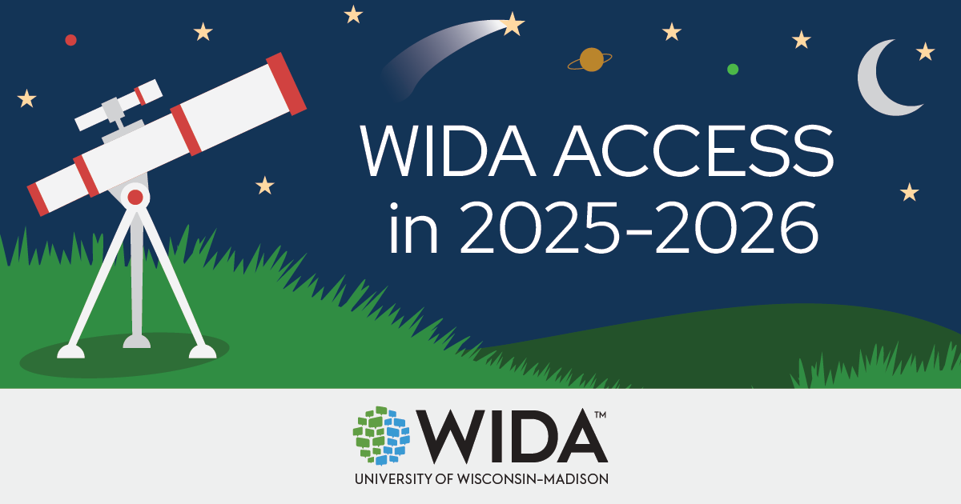
WIDA ACCESS in 2025-2026

Slide 2
Why did WIDA make changes to ACCESS?
With the release of the WIDA English Language Development (ELD) Standards Framework, 2020 Edition a few years ago, test developers have been incorporating those new standards into ACCESS test content.
WIDA fact! ACCESS is a standards-referenced test. This means that student performance is compared to the WIDA ELD Standards Framework. Any student can achieve any score, and students are not ranked against each other or against the expected performance of monolingual English speakers.

Slide 3
What are the key things to know about ACCESS this school year?
WIDA removed “for ELLs” from the ACCESS name. The new names are WIDA ACCESS for Kindergarten and WIDA ACCESS.
WIDA completely redesigned Kindergarten ACCESS and incorporated new test content that reflects the input of many experienced educators.
WIDA made all the changes to ACCESS (grades 1-12) behind the scenes, so that the test administration experience is the same this school year as it was last school year.
WIDA will release ACCESS score reports on time – on track with your regular reporting timeline.
WIDA will hold a standard setting event in July 2026 to ensure that student scores still give an accurate picture of a student’s English language development.

Slide 4
What is different about Kindergarten ACCESS this school year?
Fewer test materials to manage (no more activity board and fewer cards!)
All four domains connect to a single new storyline
Each language domain is administered once, with no starting or skipping rules
New task types that reflect everyday classroom practices
A separate score sheet to mark student scores for Listening and Speaking, Writing and Reading
Revised scoring protocols and rubrics for Speaking and Writing tasks

Slide 5
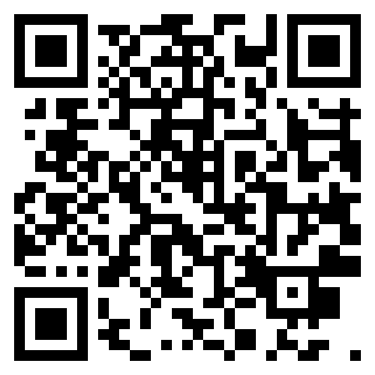

Learn more about ACCESS
Learn more on the WIDA ACCESS in 2025-2026 webpage:
wida.wisc.edu/revisingaccess

