Slide 1
WIDA Language Charts
Connecting WIDA ACCESS Scores to Curriculum, Instruction, and Classroom Assessment
Notes:
Today, I’ll be sharing with you an introduction to the WIDA Language Charts, the 2025 update to the WIDA Speaking and Writing Rubrics, which will be officially retired at the end of 2025.
Next slide

Slide 2
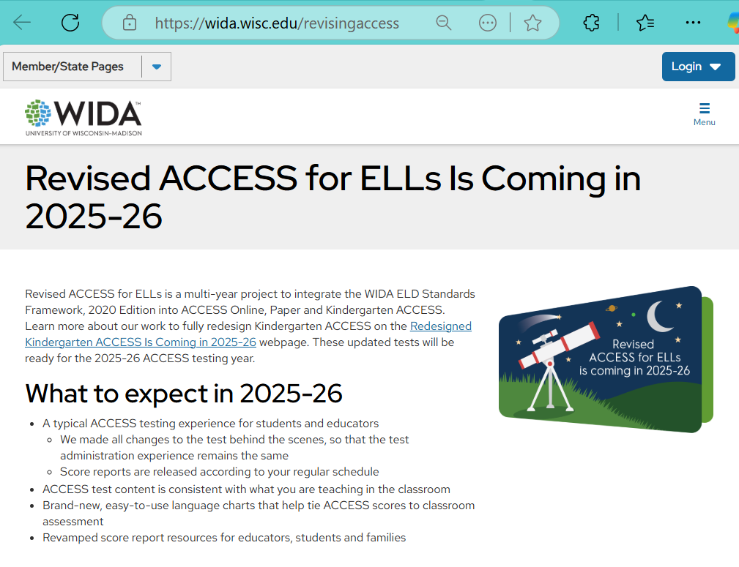
Release: May 2025
Release of the WIDA Language Charts https://wida.wisc.edu/revisingaccess
Notes:
The WIDA Language Charts will be available this May 2025 on the Revising ACCESS Webpage: [https://wida.wisc.edu/revisingaccess].
This early release, before the 2025-2026 debut of the Revised WIDA ACCESS test, is intentional. These charts not only align with the WIDA ELD Standards Framework but are specifically designed to build educator confidence with the expectations of the new assessment. WIDA’s aim is to ensure a familiar testing experience with stronger classroom connections.
Next slide

Slide 3
Theoretical Backdrop for the Proficiency Level Descriptors
Assessment scores [and related descriptors] facilitate decisions about language proficiency (Bachman & Palmer, 2010).
Scores that are useful communicate in a transparent and meaningful way (Papageorgiou & Manna, 2023).
Assessment descriptors within an assessment system are to be related and consistent (Schneider & Egan, 2014).
Assessment descriptors can reflect genre-based communicative purposes in multimodal disciplinary contexts (Fang, 2020; Halliday & Matthiessen, 2014).

Slide 4
Today’s Introduction to the Language Charts
Overview of Goals and Uses
Exploration of Key Elements
Tips for Use
Notes:
Today, we’ll focus on these topics to orient you to the chart's elements and resource. FIX THIS SENTENCE: At the end of the session, we’ll do an exploration of them to make sense of them together.
Next slide

Slide 5
Overview

Slide 6
WIDA Updates Are Part of an Aligned System
Expressive and Interpretive Language Charts (May 2025)
WIDA ACCESS
English Language Proficiency Test (2025–2026)
Expressive and Interpretive Proficiency Level Descriptors
(2020)
Notes:
In the coming year, WIDA updates are part of systematic project to align the proficiency levels used with WIDA ACCESS, with the grade-level cluster Proficiency Level Descriptors (PLDs) released in the WIDA English Language Development (ELD) Standards Framework, 2020 Edition, and now, the 2025 Language Charts.
Next slide

Slide 7
Recommendations for Uses
Connect WIDA ACCESS Scores to Curriculum, Instruction, and Classroom Assessment.
Interpret Student ACCESS scores.
Plan next steps for instruction and monitor student growth over time.
Communicate and collaborate with colleagues.
Gather classroom assessment data.
Notes:
. WIDA brought together multiple K-12 educator focus groups during the development of the Language Charts. These educators told WIDA they needed an action-oriented tool that would help them do something with their WIDA ACCESS score interpretations. As shown in this flow chart, the educators wanted a classroom-based assessment tool that would help them:
To interpret students’ WIDA ACCESS scores
To gather classroom assessment data
To plan next steps for instruction and monitor student growth over time.
To communicate and collaborate with colleagues
Next slide

Slide 8
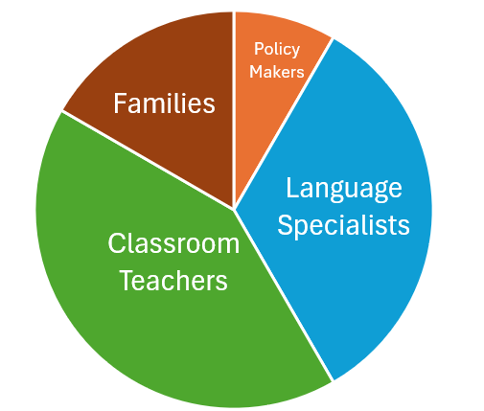
How Does Each Group Use Student Language Proficiency Data in Your Setting?
Interest Group | Using the data for . . .
Classroom Teachers
Language Specialists
Administrators & Policymakers
Families
Notes:
Short Activity:
Data and insights about your students English language proficiency can be used by a variety of stakeholders, including educators, families, and policymakers. How does each group use student language proficiency data in your setting? Would you add anyone else to this list?

Slide 9
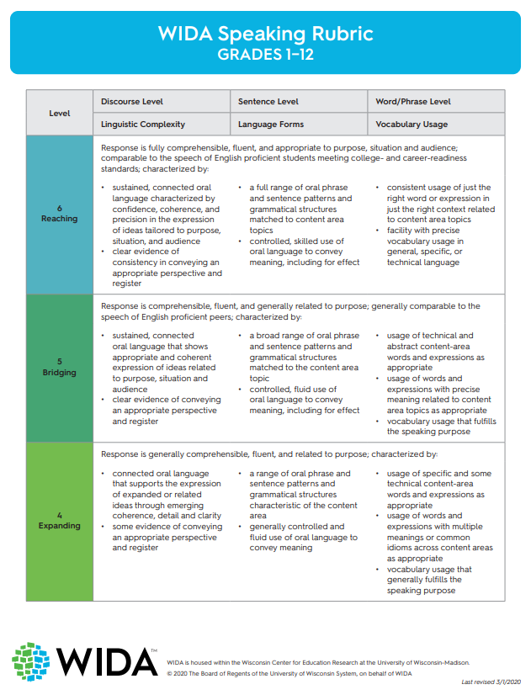
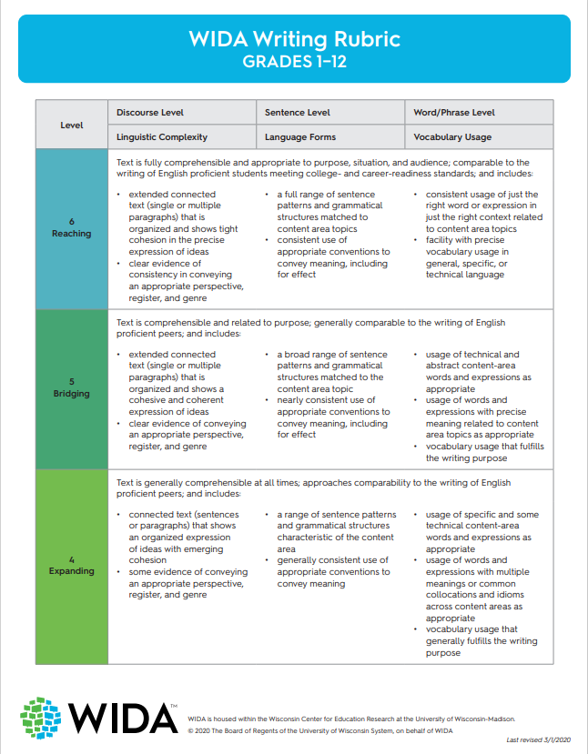
What Has Been Updated?: ACCESS Speaking and Writing Rubrics
Single continuum from Grades 1–12
Separate Speaking and Writing domains
Notes:
To understand the need for the WIDA Language Charts, let’s first look back the design of the Speaking and Writing Rubrics, which operate on a single continuum spanning grades 1 through 12 and address the Speaking and Writing domains in isolation.
Because the DRC raters who score WIDA ACCESS writing items, use a Scoring Rubrics, the word “rubric” was removed from the name of the updated tool. Instead, the updated versions are referred to as the WIDA Language Charts, the name coined by educator focus groups during development.
Next slide
WIDA Speaking Rubric Grades 1–12 (wisc.edu)
WIDA Writing Rubric Grades 1–12 (wisc.edu)

Slide 10
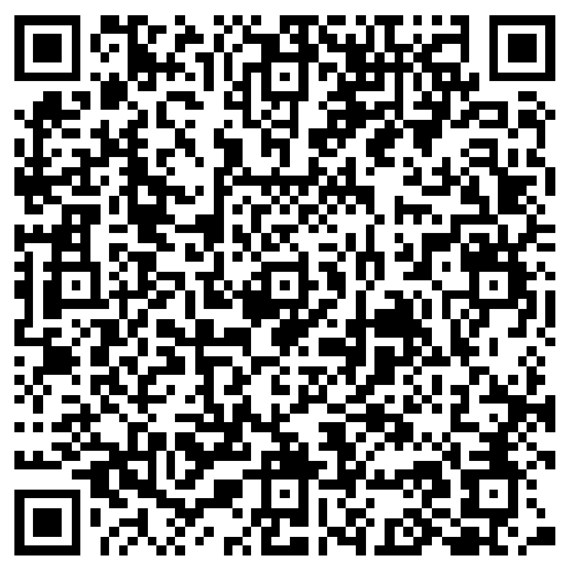
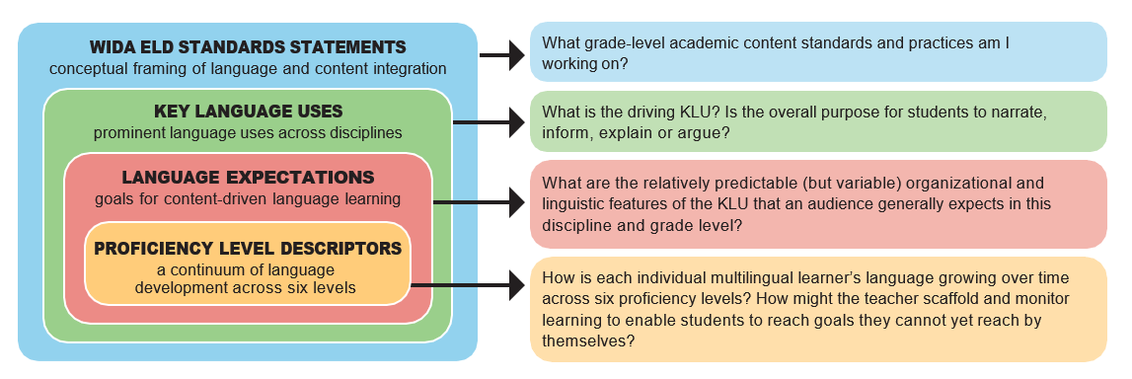
The Components of the WIDA English Language Development (ELD) Standards Framework, 2020 Edition (2)
Notes:
This slide introduces our latest ELD Standards Framework….
1. The message of the WIDA standard statements is clear – teach language and content together.
2. Key Language Uses point to four broad genre families and serve as an organizing principle for the 2020 Edition
3. The Key Language Uses (these four choices about the communicative purpose for the activity) are the realized in Grade-level Cluster Language Expectations. They offer unit level goals for learning across the standards statements and Key Language Uses; in essence, Language Expectations identify what students need to do with language to meet the academic content expectations.
4. Lastly, Grade-level Cluster Proficiency Level Descriptors provide a description of the interpretive and expressive language multilingual learners can process and produce as they approach the end of each language proficiency level.
Note: We call it a standards framework, not just standards because it is designed to be adapted and adjusted to fit local contexts and with the diversity of state academic content standards.

Slide 11
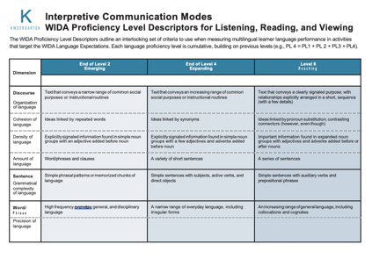
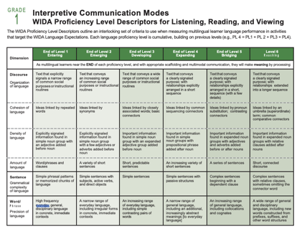
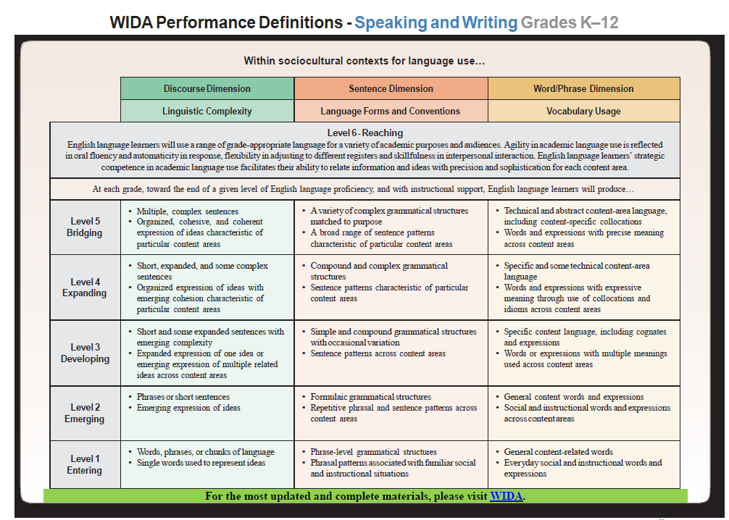
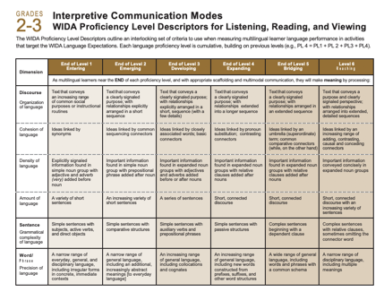
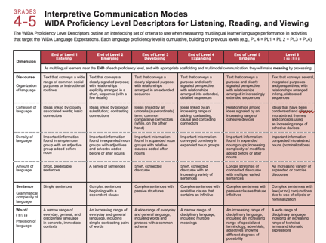
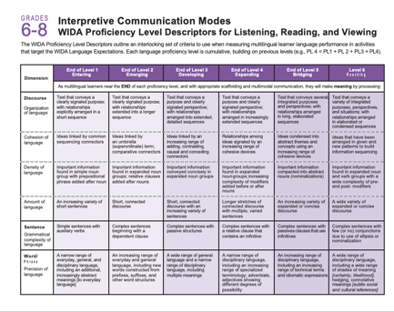
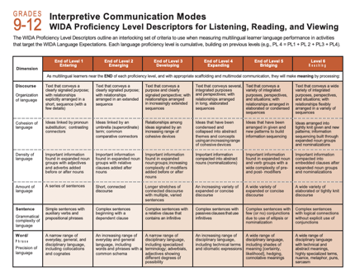
The 2020 Shift to Grade-Level Clusters
2020 Grade-Level Cluster Proficiency Level Descriptors
2012- K-12 Proficiency Level Descriptors
Notes:
Key shift to single continuum of PDs to 6 GLC sets of PLDs (but K not part of our project): 2012 PDs to 2020 PLDs.

Slide 12
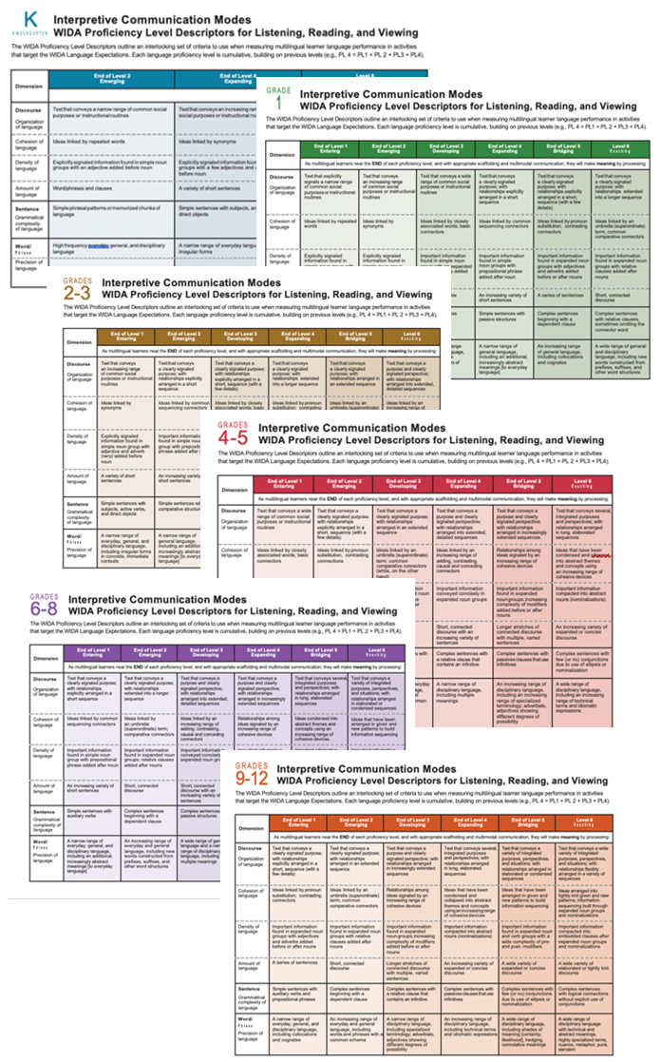
Alignment Embedded in the Language Charts
Create user-friendly descriptors that align with the 2020 Proficiency Level Descriptors (PLDs).
Two modes of communication—Expressive (Speaking, Writing, Representing) and Interpretive (Listening, Reading, Viewing)
Six progressive levels of language proficiency descriptive of what multilingual learners can do toward the end of each level
Three dimensions of language—Discourse, Sentence, Word/Phrase
Five Embedded Criteria of Language: Organization, Cohesion, Density, Grammatical Complexity, and Precision
Notes:
Let’s start with the first page of the PDF: Language Charts: Organization
You’ll see that the Language Charts are aligned with most specific component of the WIDA ELD Standards Framework, 2020 Edition, its Proficiency Level Descriptors (PLDs). The following features are carried over from the PLDs into the updates in the Language Charts. [Read bullets on slide]
…and yes, you noticed it: WIDA added an Interpretive set of Language Charts in addition to the Expressive Language Charts.
[next slide]

Slide 13
Initial Exploration

Slide 14
Two Formats
Choose the format that best fits your workflow.
PDF | Spreadsheet
Fixed and static—maintain consistency in use. Preservable appearance—easily shared Easily archived as a portfolio coversheet to monitor student progress | Flexible—manipulate individual cells of the chart to plan instruction and classroom assessment Filterable—organize cells by any column or row for student grouping
Notes:
With the PDF, you can easily review, and print, the charts and collaborate with colleagues.
With the Excel Spreadsheet
You can create personalized Language Charts, integrate with learning platforms (local learning management systems and Google Classroom), and securely share/discuss de-identified student data with colleagues.
Other uses:
Practical Application: You can quickly customize for individual or small groups by copying relevant proficiency levels and planning questions and inserting student data rows.
Helpful Resource: Sample data collection templates are included in the far-right tabs.
Accessibility Note: The spreadsheet version includes two additional columns to support screen readers and AI, ensuring accurate linking of proficiency levels and descriptors with their respective grade-level clusters and communication modes.

Slide 15
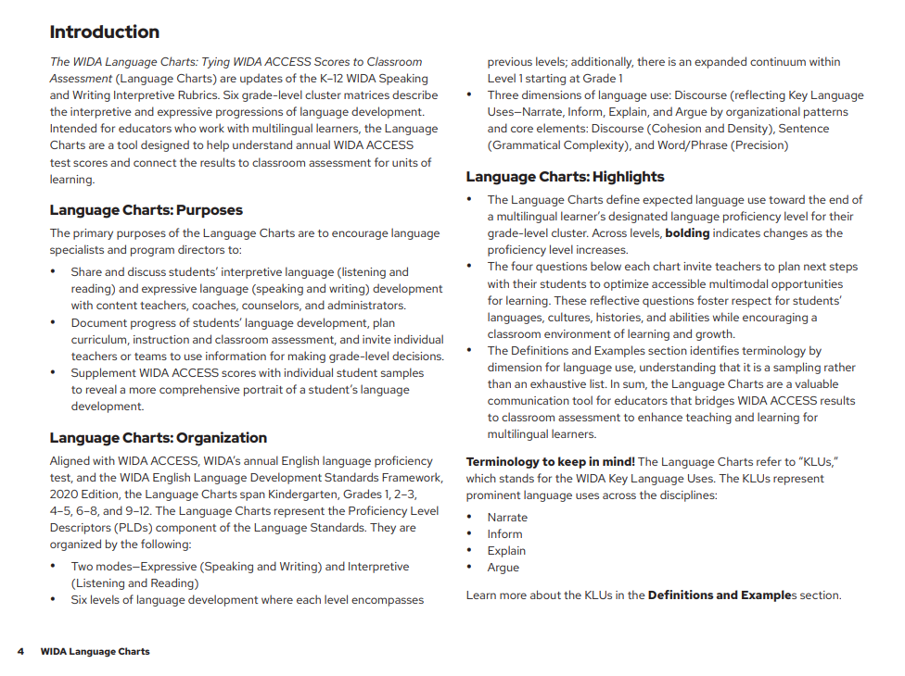
Language Charts—PDF
Please explore the Introduction:
Purposes
Organization
Highlights
Notes:
Or, you could ask:
What's the TL;DR (Too Long; Didn't Read) version of the Introduction in one funny sentence?

Slide 16
Language Charts—PDF Reflection
Please explore the Introduction: Purposes Organization Highlights |  | Please share: One initial thought One question that comes to mind One connection with your current classroom assessment practices
Notes:
Or, you could ask:
What's the TL;DR (Too Long; Didn't Read) version of the Introduction – [optional] in one funny sentence?

Slide 17
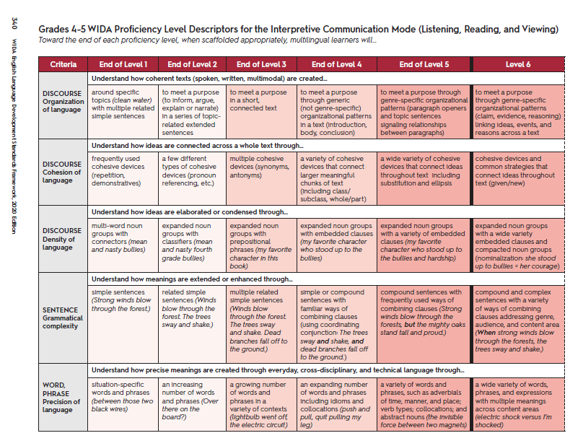
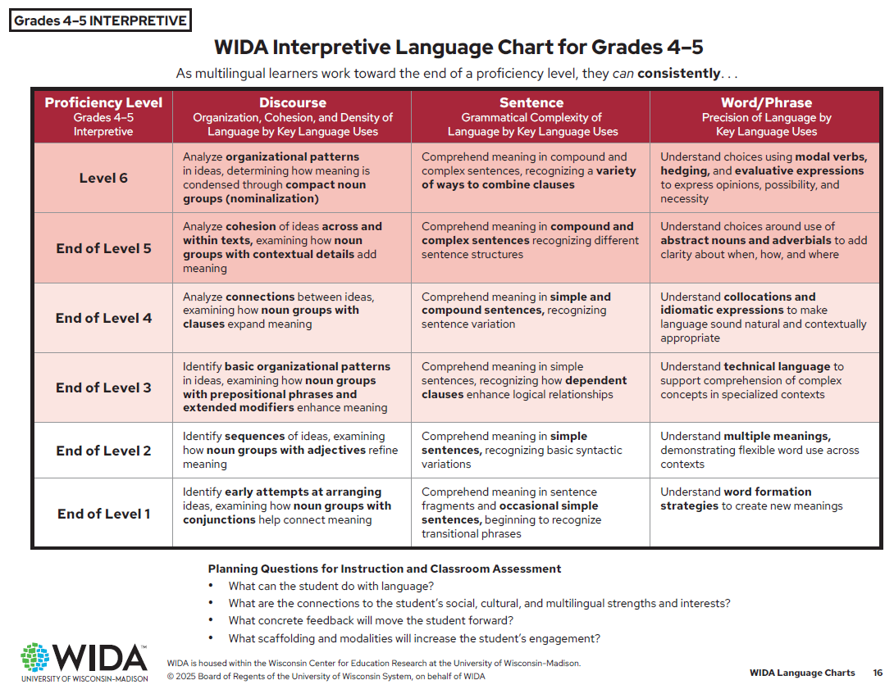
What’s the Same? What’s Different?
Comparing the 2020 PLDs and the 2025 Language Charts
Notes:
Now let’s look through the Language Charts themselves.
Let’s look at screenshots of the layouts used in the PDFs…..examining the layouts used with the PLDs and with the Language Charts. What do you notice?
[Then click your mouse to make the list below the charts appear.]
The Language Charts are designed to be easily scanned during classroom use. Let’s look at these features more closely in the next slides.

Slide 18
Similarities and Differences Outlined
2020 PLDs 6 grade-level clusters: K, 1, 2–3, 4–5, 6–8, 9–12 Horizontal display of 6 language proficiency levels Linguistically complex terminology Table divided by 5 Criteria of Language Designed for language specialists | 2025 Language Charts 6 grade-level clusters: K, 1, 2–3, 4–5, 6–8, 9–12 Vertical display of 6 language proficiency levels Plain, concise language Chart divided by 3 Dimensions of Language Designed for all K–12 educators
Notes:
Now let’s look through the Language Charts themselves.
Let’s look at screenshots of the layouts used in the PDFs…..examining the layouts used with the PLDs and with the Language Charts. What do you notice?
[Then click your mouse to make the list below the charts appear.]
The Language Charts are designed to be easily scanned during classroom use. Let’s look at these features more closely in the next slides.

Slide 19
Six Grade-Level Clusters (Aligned with ACCESS)
Kindergarten, Grades 1, 2–3, 4–5, 6–8, and 9–12
What do you notice about the different grade-level cluster Language Charts?
What do you wonder?
Notes:
Aligned with ACCESS, WIDA’s annual English language proficiency test, and the WIDA English Language Development Standards Framework, 2020 Edition (Standards Framework), the Language Charts have expanded from a Grades 1-12 continuum. Now there is a separate, developmentally appropriate Language Chart for six grade level clusters: Kindergarten, Grades 1, 2-3, 4-5, 6-8, and 9-12.
Compare the differences between grade-level cluster Language Charts: What do you notice? What do you wonder?
[next slide]

Slide 20
Dig Into the Lead-In Sentence Above Each Chart
WIDA Interpretive Language Chart for Grades 4–5
As multilingual learners work toward the end of a proficiency level, they can consistently. . .
Questions:
Can you fill in the blank below? [Look in the Tips.] Project where the student is headed on the language development continuum. For example, an overall WIDA ACCESS score of 3.6 means the student is moving toward the ____________ with their language proficiency.
What does the term consistently indicate? [Look in the Definitions section.]
Notes:
Lead-in Sentence: As multilingual learners work toward the end of a proficiency level, they can consistently. . .
Answers:
1. Project where the student is headed on the language development continuum. For example, an overall WIDA ACCESS score of 3.6 means the student is moving towards the End of Level 3 with their language proficiency.
2. Consistently: when a student reliably demonstrates the descriptor(s) over time and across various tasks, contexts, and modalities—not just in isolated instances
Followup Question: How might this information flip your script or shake up your current understanding of how different proficiency levels are used to gauge student progress?
And now for the fun part! Let's channel our inner journalists:
Can you condense your answer to that question into a catchy, attention-grabbing newspaper headline? Think punchy, intriguing, and maybe even a little bit dramatic!
[next slide]

Slide 21
Three Dimensions of Language
Shaped by Key Language Uses Organizational Patterns and Language Features
Discourse Organization, Cohesion, and Density of Language by Key Language Uses | Sentence Grammatical Complexity of Language by Key Language Uses | Word/Phrase Precision of Language by Key Language Uses
*Note: The WIDA Key Language Uses (KLUs) are Narrate, Inform, Explain, Argue.
Notes:
The Language Charts focus on the 3 Dimensions of Language. The descriptors for the Discourse Dimension, the broadest Dimension of Language streamline and synthesize the 3 PLD Criteria: Organization, Cohesion, and Density of Expression by KLUs. The Sentence Dimension descriptors address the Grammatical Complexity of Language, and the Word/Phrase Dimension address the Precision of Language.
Next slide

Slide 22
Dimensions of Language
Discourse
How does the discourse dimension looks in one grade level cluster across levels?
How does it look across grade level clusters on the same level?
Sentence
How does the sentence dimension looks like in one grade level cluster across levels?
How does it look like across grade level clusters in one level?
Word/ Phrase
How does it look across levels in one grade level cluster?
Notes:
OPTIONAL Activity

Slide 23
Not Sure of a Term?
Look in the Definitions and Examples section:
Discourse Dimension Definitions
Key Language Uses (KLUs): A component of the WIDA ELD Standards Framework, 2020 Edition. They consist of four high-leverage genre families identified across state academic content standards. Each KLU is defined by its communicative purpose—Narrate, Inform, Explain, and Argue—and characterized by specific language patterns and features. These KLUs are interconnected and often blend together in extended texts. For example, Inform may precede Explain or Argue to introduce and define a topic, while Explain may lead into Argue to supports claims with logical reasoning.
Notes:
The Definitions and Examples section identifies terminology by language dimension, understanding that it is a sampling rather than an exhausted list.
Let’s look up the term KLU in the Definitions and Example section of the Language Charts.
The language in all 3 dimensions are shaped by the WIDA Key Language Uses (KLUs). The KLUs are a component of the WIDA ELD Standards Framework, 2020 Edition that consists of four high-leverage genre families identified across state academic content standards. Each genre family/KLU is defined by its communicative purpose (Narrate, Inform, Explain, Argue) and characterized by specific language patterns and features.

Slide 24
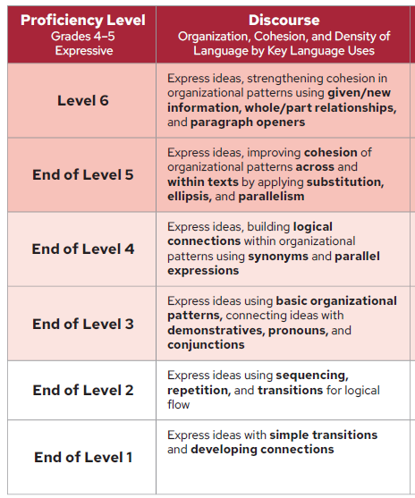
Discourse Dimension: Expressive
As multilingual learners work toward the end of a proficiency level, they can consistently.
All three criteria are synthesized into the Expressive descriptors, with cohesion of language called out at end of the descriptor.
Notes:
While all three discourse criteria are embedded within the Discourse Dimension Descriptors, you’ll notice that the end of each mode calls out a difference emphasis – with cohesion of language called out at the end of the Expressive descriptors and density of language called out for at the end of the Interpretive descriptors.
In the focus group research, educators liked how the two modes could be paired together for combined Expressive and Interpretive activities in the classroom.

Slide 25
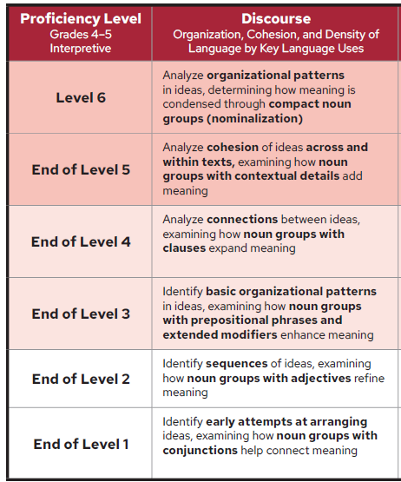
Discourse Dimension: Interpretive
As multilingual learners work toward the end of a proficiency level, they can consistently.
All three criteria are synthesized into the Expressive descriptors, with density of language called out at end of the descriptor.
Notes:
While all three discourse criteria are embedded within the Discourse Dimension Descriptors, you’ll notice that the end of each mode calls out a difference emphasis – with cohesion of language called out at the end of the Expressive descriptors and density of language called out for at the end of the Interpretive descriptors.
In the focus group research, educators liked how the two modes could be paired together for combined Expressive and Interpretive activities in the classroom.

Slide 26
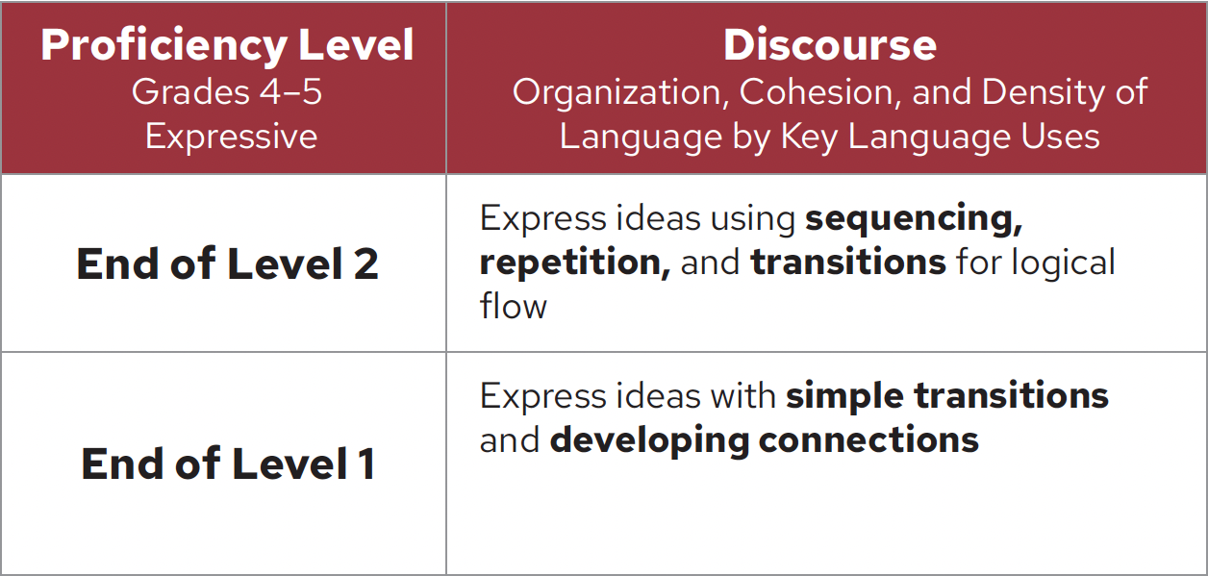
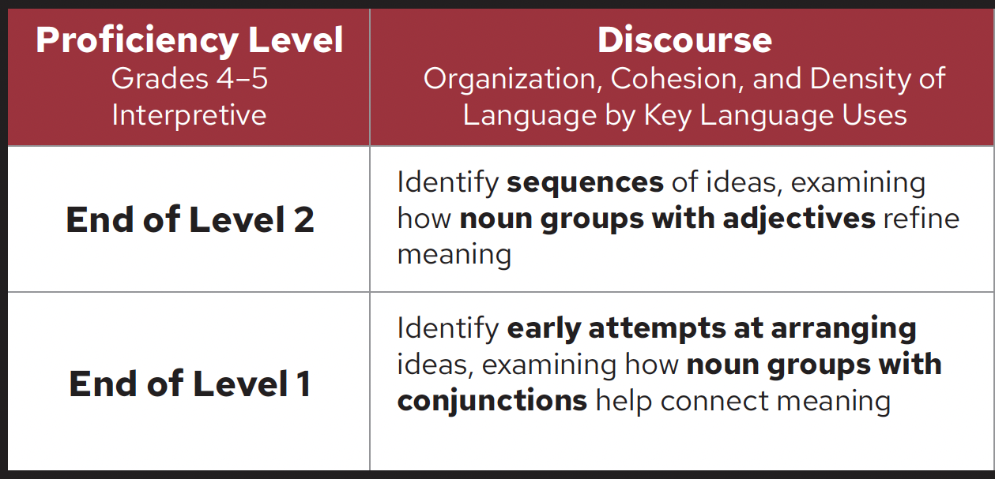
Option: Use Both Expressive and Interpretive Descriptors with Combined Interpretive/Expressive Activities
As multilingual learners work toward the end of a proficiency level, they can consistently . . .
Expressive Discourse Descriptors
All 3 criteria, with cohesion called out at end of descriptor
Interpretive Discourse Descriptors
All 3 criteria, with density called out at end of descriptor
Notes:
While all three discourse criteria are embedded within the Discourse Dimension Descriptors, you’ll notice that the end of each mode calls out a difference emphasis – with cohesion of language called out at the end of the Expressive descriptors and density of language called out for at the end of the Interpretive descriptors.
In the focus group research, educators liked how the two modes could be paired together for combined Expressive and Interpretive activities in the classroom.

Slide 27
Descriptors Supported by Teacher-Tested Definitions With Examples
Compound Sentences: Contain two or more independent clauses, often linked with coordinating conjunctions, commas, or semicolons. | Coordinating conjunctions: for, and, nor, but, or, yet, so I ran and they slept. I wanted to run, but it was raining. Can we go running, or will you be too busy? I finished, so now let’s eat.
Notes:
The educators told us they definitely wanted a supporting Definitions and Examples document. But looking up terms in the printed versions of the Charts was not an efficient process for most educators.
The team placed a link below the Chart. In this way, educators can click on the link and get access to Definitions and Example document from the WIDA Website.
Next slide

Slide 28
Proficiency Level Differences
Bold indicates changes as the proficiency level increases.
Notes:
The Language Charts define expected language use toward the end of multilingual learner’s designated language proficiency level for their grade-level cluster. Across levels, bolding indicates changes as the proficiency level increases.

Slide 29
Descriptors Feedback
From the Fall 2024 Language Charts Usability Study:
Participant 7: “When I saw the Expressive Language Charts, I was very excited about the streamlined descriptors because I think they make sense. . . . particularly for language specialists. It’s a way to get a good start when you’re talking with your colleagues in content areas.”
Notes:
Let me share a response from our usability study about educator reactions to the descriptors themselves..
Read quote
Next slide.

Slide 30
Proficiency Levels
. . . indicate cumulative language development. As the proficiency level increases, so too does the students’ language repertoire.
Proficiency Level
Level 6 [Encompasses Levels 1 + 2 + 3 + 4+ 5 + 6]
End of Level 5 [Encompasses Levels 1 + 2 + 3 + 4+ 5]
End of Level 4 [Encompasses Levels 1 + 2 + 3 + 4]
End of Level 3 [Encompasses Levels 1 + 2 + 3]
End of Level 2 [Encompasses Levels 1 + 2]
End of Level 1 [Encompasses Level 1 from Previous Grade-Level Clusters]
Notes:
During the usability study, educators weren’t sure if student performance only relied on the descriptors at a particular performance level. Consistent with the 2020 PLDs, we wanted to show that each proficiency level shows builds on the previous.
Next slide

Slide 31
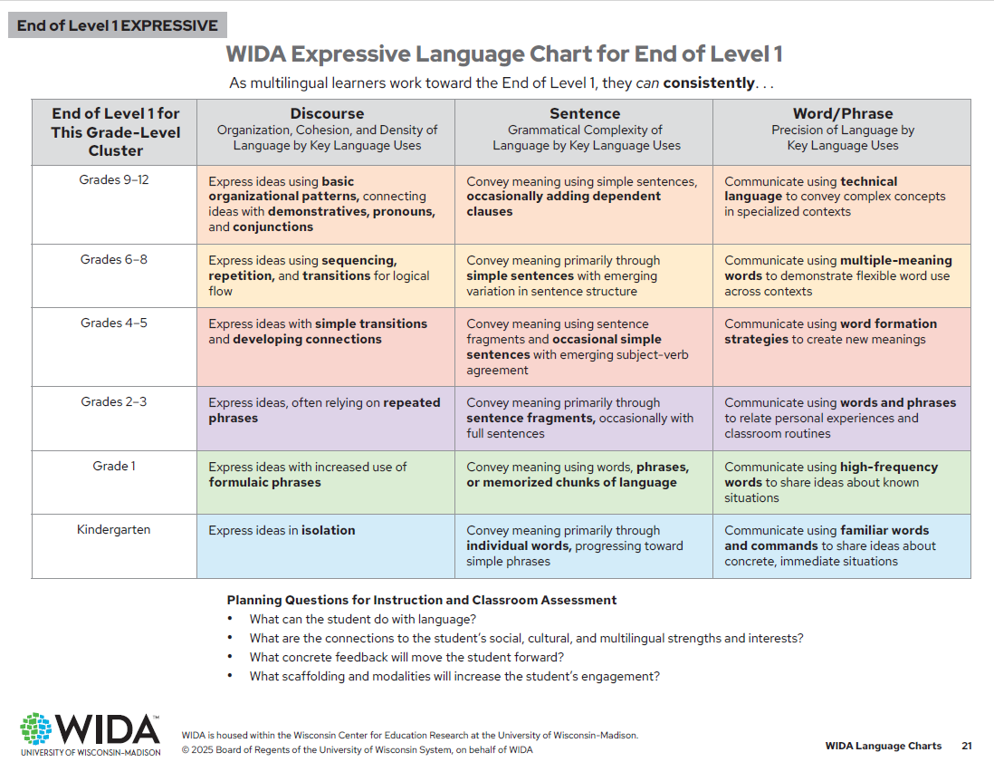
Expanded Continuum Within End of Level 1 More support for newcomers!
Notes:
Now, let me show you a unique feature within the Language Charts: An expanded continuum of descriptors within Level 1. There is a separate chart for the End of Level 1 Continuum. But if you look in the spreadsheet, you’ll see a version below each grade-level cluster chart.
If the student hasn’t reached End of Level 1 yet, these descriptors can provide a way to showcase the successes these students are making as they work towards the End of Level 1 for their grade-level cluster. This is especially helpful for students in the upper elementary and secondary grades.

Slide 32
End of Level 1 Chart
From the Fall 2024 Language Charts Usability Study:
Participant 10: “I really struggled as a fifth grade Newcomer teacher. I was like, oh, what do I do? Some of my students weren’t yet at End of level 1. Now I can show the positive progress they’ve made. . . . so it’s more about the delta [change]: Showing where the student started and where they moved to.”
Notes:
And because we’re not restricted to one page (of a PDF), we now can provide more information to support upper grade students whose performance is still working towards End of Level 1 (Newcomers and SLIFE students?)
Let me share a response from our usability study about this challenge.
Read quote
Next slide.

Slide 33
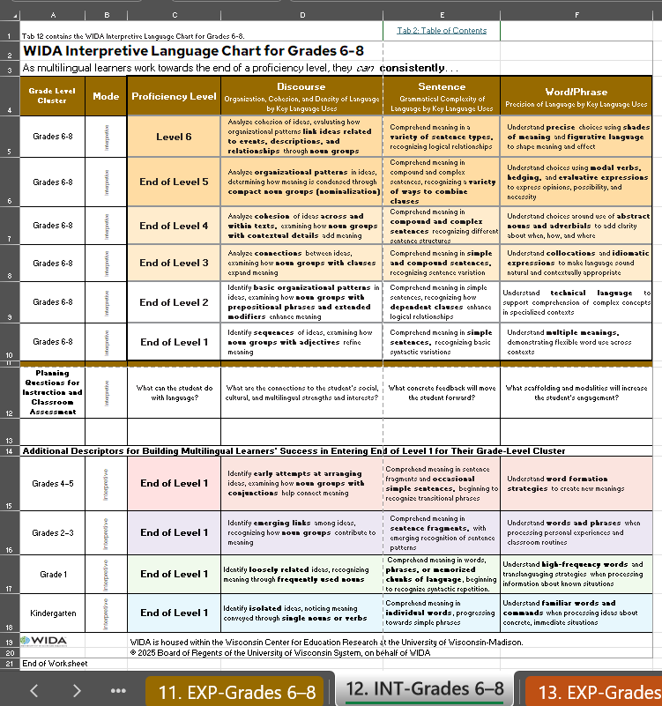
Spreadsheets
Going beyond a single page, the spreadsheet presents the grade-level cluster chart at the top, followed by a more detailed breakdown of the End of Level 1 descriptors for a deeper understanding of early language development.
Notes:
At this point, we suggest the facilitator open a copy of the Spreadsheet version of the Language Charts and show this view to attendees. Use the Table of Contents in Tab 2 to explore the contents of the spreadsheet.
Comment: Educators found it easier to copy text from the spreadsheets (for example, for small group instruction)

Slide 34
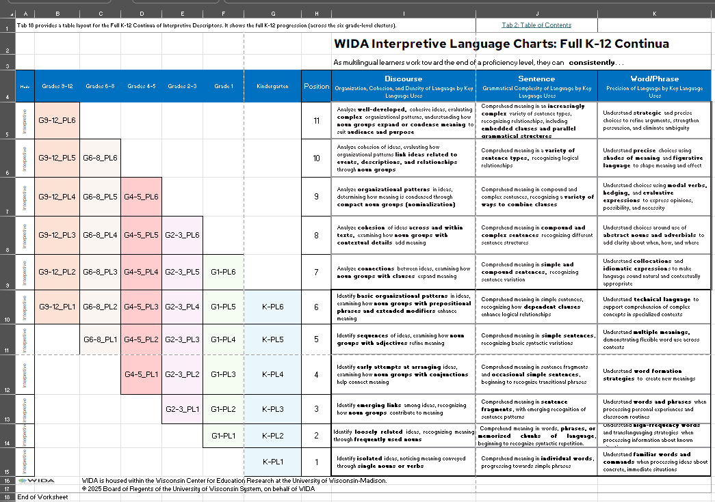
Formats
Screen-reader friendly PDFs
Easily copied text from spreadsheets
Easy spreadsheet navigation via the Tab 2 Table of Contents
Multiple descriptor layouts for flexible application
Notes:
The Language Charts are provided as accessible PDFs for screen readers complemented by spreadsheets with easily copied text. Tab 2 in the spreadsheet contains a table of contents with jumplinks that will allow you to easily navigate between tabs. The spreadsheet also includes multiple descriptor layouts for flexible use. Releasing the Charts as spreadsheets in addition to PDFs provides districts – especially those that have gone digital only – an easier way to integrate the Charts.
At this point, we suggest the facilitator open a copy of the Spreadsheet version of the Language Charts, using the Table of Contents in Tab 2, explore the grade-level cluster tabs, the Definitions and Examples tab, the sample data collection tabs, and Tabs 17-20. Here, they’ll find the full continua in both a table format and in a vertical format.

Slide 35
Planning Questions Below Charts
Planning Questions for Instruction and Classroom Assessment
What can the student do with language?
What are the connections to the student’s social, cultural, and multilingual strengths and interests?
What concrete feedback will move the student forward?
What scaffolding and modalities will increase the student’s engagement?
Notes:
Look below each Chart. There are 4 questions. In the PDF, they are placed in a bulleted list; in the spreadsheet, they are placed in a horizontal row.
• Teachers are invited to respond to four probes below each matrix to plan next steps with their students to optimize accessible multimodal opportunities for learning. The intent of these reflective questions is to foster a classroom environment that encourages learning and growth while respecting the languages, cultures, histories, and abilities of the students.
The Planning Questions help bolster connections between assessment and instruction in the classroom. As educators gather data on what students can do with language, they can jot down notes to themselves for these questions:
What can the student do with language?
How can I connect to the student's social, cultural, and multilingual strengths and interests?
What concrete feedback will move the student forward?
What scaffolding and modalities will increase the student's engagement?
Next slide

Slide 36
Planning Questions
From the Fall 2024 Language Charts Usability Study:
Participant 4: “[The planning questions below the Language Charts] were a good reminder of how amazing our students are and how complex developing proficiency in language can be.”
Notes:
We’ve also placed formative assessment planning questions below the charts. Here’s another response from our usability study.
Read quote
Next slide.

Slide 37
Discussion
Share two words about your impression of the WIDA Language Charts.
Notes:
To summarize, we’ve tried to build out the updates to the Speaking and Writing Rubrics to offer streamlined yet aligned descriptors with the 2020 PLDs. In the chat box, please take a moment to share two words about your impressions of the Language Charts.
Q: How do you see these interplaying with the established PLDs? The Language Charts are closely aligned with the 2020 PLDs. The PLDs remain the "official" WIDA Standards -- and definitely still can be used. We've just created a streamlined, digital version in the Language Charts in response to educator feedback.
Next slide

Slide 38
What questions do you have?
Notes:
IDA is releasing this update prior to the Revised ACCESS test next year to underscore the theme: Same Testing Experience, Better Classroom Connections.
Prep for next year’s Revised ACCESS.
We are giving 1 ½ years notice to work in conjunction with ACCESS ISRs
Sample questions asked:
When are these going to be available to educators?
May of 2025
Will these be part of in-person PL trainings?
There are plans to build professional learning opportunities for 2026
Is there going to be webinars or professional development with this from WIDA ?
All professional learning will be developed in 2026

Slide 39
The Language Charts
Planning for Communication, Curriculum, and Classroom Assessment

Slide 40
WIDA Expressive and Interpretive Language Charts
Establish Curricular Goals for Units of Learning by:
Integrating Content (State Academic Standards) and Language (ELD Standards Statements + Language Expectations + Language Functions)
Example Unit Goals for Grades 4-5
Students will craft rules and explain how they help solve problems (D2Civ.12.3-5; ELD D2.Civ.13.3-5) by:
narrating their lived experiences
reporting on explicit behavior, acting on feedback to revise understandings (ELD-SI-4-12. Narrate, Inform, Explain)
analyzing sources for a series of contributing factors or causes (ELD-SS.4-5. Explain. Interpretive)
generalizing probable causes and effects of developments or events (ELD-SS.4-5.Expressive.Explain)
Represent grade-level cluster Language Expectations across standard statements
Include Key Language Uses
Address select Language Functions

Slide 41
Example Final Project for the Unit: Grades 4—5
You can choose one project.
Make a colorful poster with text with a friend.
Interview friends and summarize what they say orally or in writing.
Produce a personal narrative or story.
Topic: How Might We Stop Bullying or Cyber Bullying?
Criteria for Success
How would you use the Expressive Language Chart to create a rubric?

Slide 42
Interpreting a Final Project (Choice 1)
Grades 4–5
Word/Phrase Dimension
Select words and phrases with increasing awareness of language choices, at times with language for evaluation, obligation (should, must, need to, ought).
Words and phrases present in the poster: be aware, must report, adult, need to ask, should consult . . .

Slide 43
Interpreting a Final Project (Choice 2)
Grades 4–5
Level 6 Sentence Dimension
Convey meaning using compound and complex sentences, with a variety of clauses
What is cyberbullying?
What should I do about it?
Who should I talk to?

Slide 44
Sample
If it’s happening to you, the first thing they said is you HAVE to keep screenshots and stuff as proof. Don't even try to fight back or say mean things back, just maybe tell them to stop calmly. If they don’t stop, you gotta write everything down. Depending on how bad it is and where it’s happening, you can try to block the person and report them to the website or app. If you’re actually scared or they’re threatening you, you need to call the police. They even said that grown-ups who are getting really messed with online might need to talk to a lawyer.
But the most important thing they said is to talk to a grown-up you trust. Like your parents, teachers, or the school counselor. They can help you figure things out and make it stop. Our school even has rules about this stuff. And yeah, if it’s really serious, the police might need to get involved. So, basically, keep proof, don’t fight back, tell someone you trust, and get help!
I can find several compound sentences. Next steps: Rewrite using complex
sentences using because, since, who, that

Slide 45
Interpreting a Final Project (Choice 3)
Grades 4–5
Level 6 Discourse Dimension
Express coherent and cohesive ideas by Key Language Use in the content areas, making connections within and across text and attending to audience.
Phones can say mean words. Computers say bad words. People say I was ugly. I was stupid. I feel very sad.
My mami talk to me about kind words and be safe online. She show me how to block mean kids. She tell me what to do.
Now I feel better. I use my computer to have fun and do my work. I am careful. I only talk to people I know.
I think we can stop cyberbullying if everyone is kind. We should use nice words. We should think before text. We should tell a grown-up if someone is mean to us online.
I hope everyone is kind online. I hope we make the internet a happy place.

Slide 46
Teacher Self-Reflection and Feedback
Planning Next Steps for Instruction and Classroom Assessment
What can my student(s) currently do with language?
What social, cultural, and multilingual strengths and interests shape my student(s)’ communication?​
What strategies might I use to support and scaffold student learning?
What are my next teaching moves? How can I connect to my student(s)’ strengths? ​

Slide 47
The Process of Rating Student Samples
Read, reflect, and discuss the Tips section of the Language Charts.
How does this already connect to what you’re doing in the classroom?
Where do you need more information? Is anything unclear?
Is there anything we can practice together?
Understanding and Interpreting WIDA ACCESS scores
Co-planning curriculum, instruction, and classroom assessment
Selecting anchors for each Grade Level Cluster or Proficiency Level
Documenting student language growth over time
Conferencing with students and family members
Offering evidence in MTSS/ referral meetings
Choosing formats that match your teaching style

Slide 48
Rating Student End-of-Unit Project/ Samples Together
Be familiar with the end of unit assessment and mentor texts used
Decide the characteristics of the student sample to review
Decide on the language criteria to begin analysis
Discuss your findings
Move on to another language criteria

Slide 49
Connect to Tips (and WIDA Focus Bulletin)
Here at level three, it’s connecting larger chunks of text. I started to interpret that as do we have two chunks that we’re connecting, like a paragraph and a paragraph?
Versus connecting words, phrases, and sentences to build a paragraph. I had not understood that from my reading of the proficiency level descriptors in the framework.
So in many ways . . . What I'm saying is this chart helped me . . .
Notes:
FocusBulletin-Rating-Multilingual-Learners-Written-Language-Consistently.pdf
This 2023 Focus Bulletin was featured in today’s email newsletter. It expands on concepts we start to discuss in our Language Chart Tips. Love the word “consistently” in the title.

Slide 50
Activity
Brainstorm Rollout Topics for Grade-Level Teams or Professional Learning Communities
For example:
Discussing the Process of Rating Student Samples
What else?
Notes:
OPTIONAL ACTIVITY Have small groups brainstorm topics for discussion

Slide 51
Next Steps
Curriculum | How would you use the WIDA Language Charts for curriculum design?
Instruction | How would you use the WIDA Language Charts to inform instruction?
Classroom Assessment | How would you use the WIDA Language Charts for end of unit assessment?
This Photo by Unknown Author is licensed under CC BY.
Notes:
How would you use the WIDA Language Charts for curriculum design?

Slide 52
Inclusion Activity
Drop an emoji into the chat that captures your initial reactions to your review of the Expressive and Interpretive Language Charts.
Notes:
We are going to get deeper into our reflections during our group discussion together, however, we would love for you to drop an emoji into the chat that captures your initial reactions to your review of the interpretive and expressive charts

Slide 53
References (1)
Bachman, L. F., & Palmer, A. S. (2010). Language assessment in practice: Developing language assessments and justifying their use in the real world. Oxford University Press.
Diaz-Bilello, E., & Anthony, J. (2024). District and school practices and assessments to support a learning-centered vision. In Marion, S. F., Pellegrino, J. W., & Berman, A. L. (Eds.), Reimagining balanced assessment systems (pp. 167–199). National Academy of Education.
Educause. (2019). Report from the 2018 EDUCAUSE Task Force on Digital Transformation. https://library.educause.edu/-/media/files/library/2018/11/dxtaskforcereport.pdf
Fang, Z. (2020). Toward a linguistically informed, responsive and embedded pedagogy in secondary literacy instruction. Journal of World Languages, 6(1–2), 70–91. https://doi.org/10.1080/21698252.2020.1720161
Gottlieb, M. (2023). Right from the start: Enriching learning experiences for multilingual learners through multiliteracies. Center for Applied Linguistics.

Slide 54
References (2)
Gottlieb, M. (2022). Classroom assessment in multiple languages: A handbook for teachers. Corwin.
Halliday, M.A.K., & Matthiessen, C. (2004). An introduction to functional grammar. Routledge.
Harding, L. (2021). Language assessment: Current trends, future challenges. SALT Journal at Teachers College, Columbia University. https://www.youtube.com/watch?v=UljPM8H9ywI
Marion, S. F., Pellegrino, J. W., & Berman, A. L. (Eds.). (2024). Reimagining balanced assessment systems. National Academy of Education.
Papageorgiou, S., & Manna, V. (2023). Meaningful language test scores: Research to enhance score interpretation. John Benjamins Publishing Company.
Park, H. (2024). Examination of the current implementation status of WIDA English Language Development Standards Framework, 2020 Edition (WIDA Research Report No. RR-2024-2). Wisconsin Center for Education Research.

Slide 55
References (3)
Scheider, M.C., & Egan, K. (2014). A handbook for creating range and target performance level descriptors. The National Center for Improvement of Educational Assessment.
Shafer Willner, L., & Gottlieb, M. (2024). Aligning proficiency level descriptors with audiences and uses: Enhancing equitable communication in a K–12 language assessment system. Paper presented at Language Testing Research Colloquium (LTRC), Innsbruck, Austria.
Shafer Willner, L., Gottlieb, M., Kray, F.M., Westerlund, R., Lundgren, C., Besser, S., et al. (2020). Appendix F: Theoretical foundations of the WIDA English language development standards framework, 2020 Edition. In WIDA English language development standards framework, 2020 edition: Kindergarten–grade 12 (pp. 354–364). Board of Regents of the University of Wisconsin System.
WIDA. (2020). WIDA English language development standards framework, 2020 edition: Kindergarten–grade 12. Board of Regents of the University of Wisconsin System. https://wida.wisc.edu/resources/wida-english-language-development-standards-framework-2020-edition

