Slide 1
Meet the WIDA Language Charts

Slide 2
What are the WIDA Language Charts?
Represent the WIDA Proficiency Level Descriptors
Span Kindergarten, Grades 1, 2–3, 4–5, 6–8, 9–12 and are organized by:
Communication Modes of Expressive (Speaking, Writing) and Interpretive (Listening, Reading)
Six levels of language development; each level encompasses previous levels
Three dimensions of language use:
Discourse (reflecting Key Language Uses—Narrate, Inform, Explain, and Argue by organizational patterns and core elements; Cohesion; and Density)
Sentence (Grammatical Complexity)
Word/Phrase (Precision)

Slide 3
Why did WIDA create the Language Charts?
The charts connect WIDA ACCESS to the WIDA ELD Standards Framework, 2020 Edition
They make WIDA Proficiency Level Descriptors clearer, more actionable and directly connected to classroom instruction
They are a resource for all educators (even those without specialized language backgrounds)

Slide 4
Resources that connect WIDA ELD Standards to ACCESS
Aligned to 2012 Amplification of the WIDA ELD Standards
WIDA Speaking Rubric Grades 1-12
WIDA Writing Rubric Grades 1-12
WIDA Speaking Rubric Kindergarten
WIDA Writing Rubric Kindergarten
Aligned to WIDA ELD Standards Framework, 2020 Edition
WIDA Language Charts
WIDA Proficiency Level Descriptors

Slide 5
Comparing Proficiency Level Descriptors to Language Charts
WIDA Proficiency Level Descriptors
Table divided by 5 Criteria of Language
Horizontal display of 6 language proficiency levels
Specialized terminology
Designed for language specialists
WIDA Language Charts
Chart divided by 3 Dimensions of Language
Vertical display of 6 language proficiency levels
Simple terminology
Designed for all K-12 educators

Slide 6
How to use Language Charts in 2025-2026
Get familiar with the revised expectations of WIDA ACCESS and WIDA ACCESS for Kindergarten
Collaborate with content area colleagues
Plan curriculum, instruction and classroom assessment
Trace student growth in language development from unit to unit
Note: Beginning with WIDA ACCESS scores in the 2026-2027 WIDA testing year, you can also use the Language Charts to interpret and communicate about ACCESS scores.

Slide 7
Experience the Charts in Two Formats
PDF
Review the charts anytime
Print the charts and keep them handy
Share the charts with colleagues
Excel Spreadsheet
Easily copy and paste information from the charts into your own tools
Create personalized charts
Customize the charts for individual or small groups
Notes:
With the PDF, you can easily review, and print, the charts and collaborate with colleagues.
Just like the PDF allows for easy review, printing, and sharing of static charts, the Excel spreadsheet empowers you to quickly review and print personalized Language Charts and securely collaborate with colleagues on de-identified student data.
While the PDF preserves a fixed appearance, the spreadsheet allows you to maintain a clear structure for easy sharing and digital archiving in student portfolios. Plus, you gain the unique ability to manipulate data, create custom tools, integrate with learning platforms (e.g., local learning management systems and Google Classroom), and filter information for deeper insights.
Practical Application: You can quickly customize for individual or small groups by copying relevant proficiency levels and planning questions and inserting student data rows.
Helpful Resource: Customization Ideas and Sample data collection templates are included in the far-right tabs.
Accessibility: The spreadsheet version includes two additional columns to support screen readers and AI, ensuring accurate linking of proficiency levels and descriptors with their respective grade-level clusters and communication modes.

Slide 8
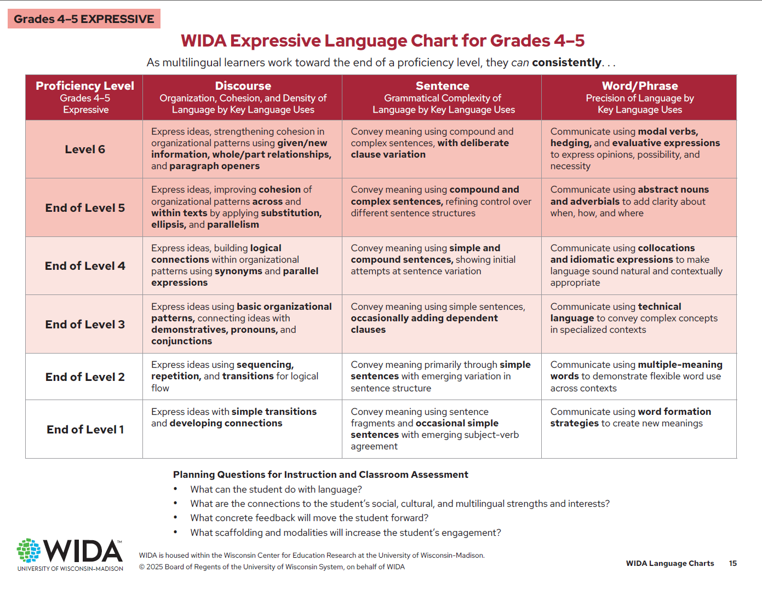
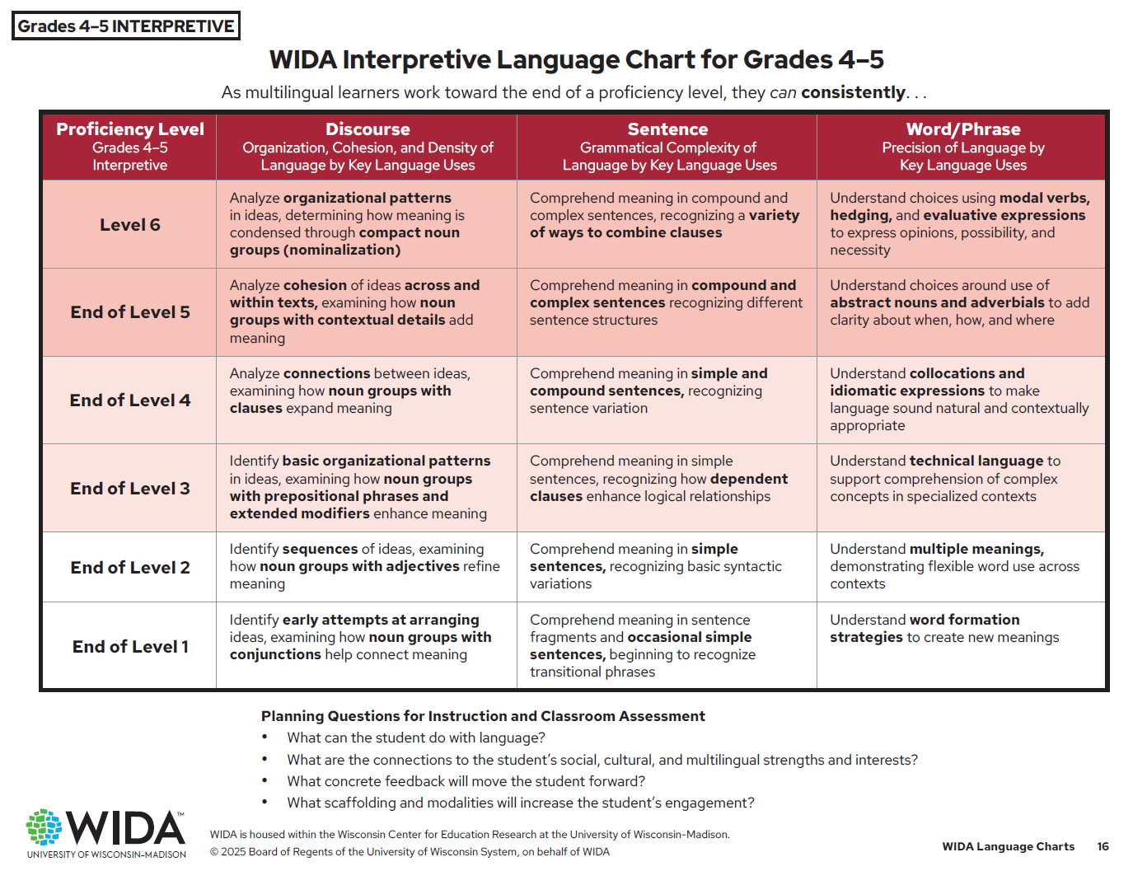
Interpretive and Expressive Charts

Slide 9
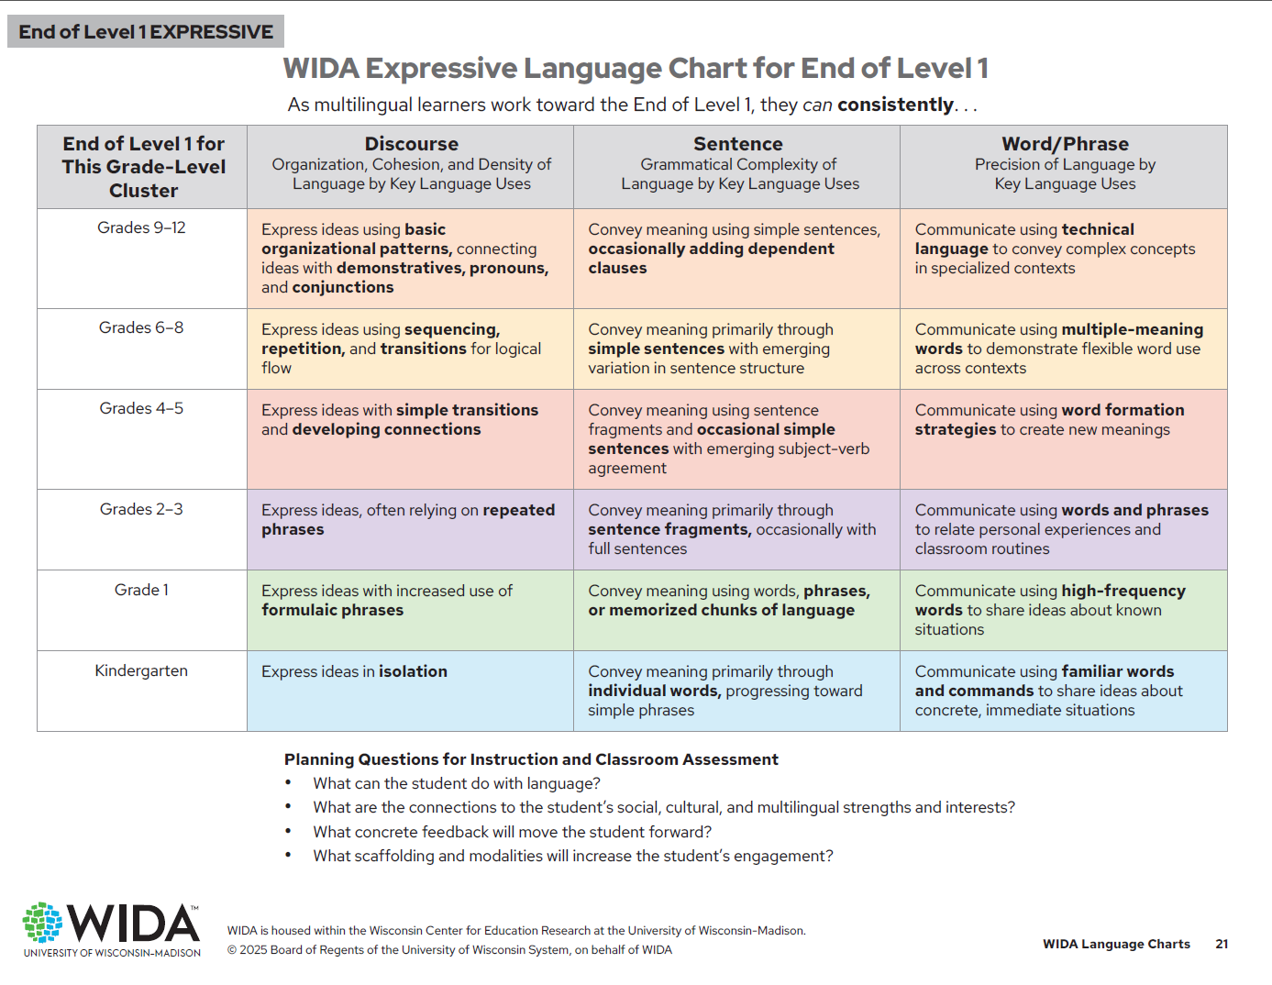
End of Level 1
Expanded continuum of descriptors within End of Level 1
Showcase the successes students make as they work toward the End of Level 1 for their grade-level cluster

Slide 10
Things to keep in mind
Use the four questions below each chart to plan next steps for students
Refer to the Definitions and Examples section at the end of the document for terminology by dimension for language use
Rely on the Tips for Educators section for specific ways to use the charts

