Slide 1
How to use this toolkit
This toolkit helps educators share important information and resources with colleagues during staff meetings, professional learning communities, and other professional development opportunities.
Educators may share, adapt, and reproduce these materials for noncommercial educational purposes. These materials may not be used for commercial purposes or incorporated into fee-based training, consulting, or other activities.

Slide 2
Understanding WIDA ACCESS Standard Setting 2026​
An educator powered process​

Slide 3
Before we talk about ​ standard setting…​

Slide 4
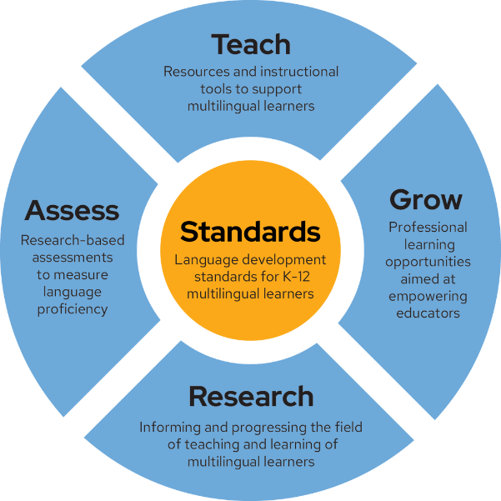
What is WIDA?
WIDA provides a trusted, comprehensive approach to supporting, teaching, and assessing multilingual learners.

Slide 5
WIDA creates
Language development standards frameworks (English and Spanish)
English language proficiency assessments
(WIDA ACCESS, WIDA Screener, WIDA MODEL)
Professional learning to support educators of multilingual learners
These resources are available to all schools and districts in the WIDA Consortium.

Slide 6
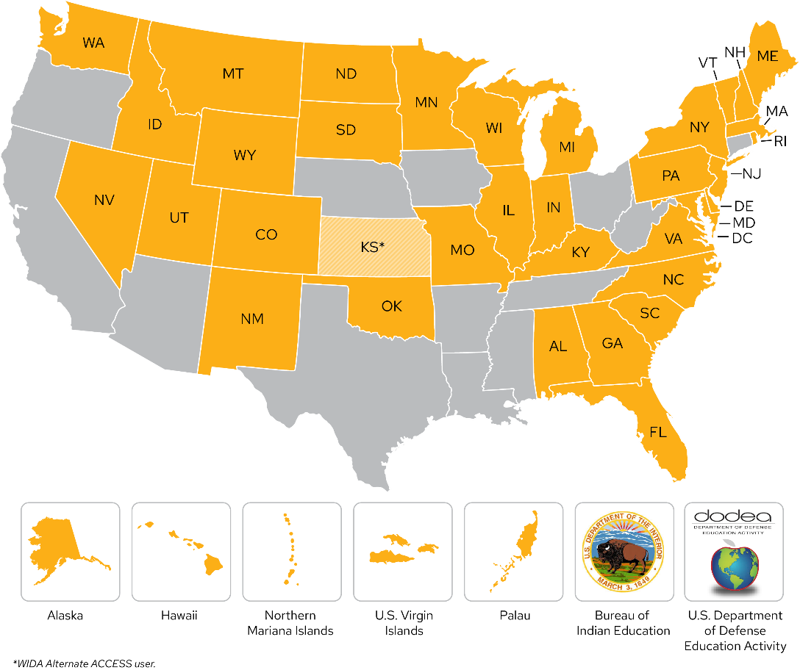
The WIDA Consortium
The WIDA Consortium is made up of 42 states, territories, and federal agencies. Additionally, WIDA Español supports Spanish language instruction in grades K–12.

Slide 7
What is WIDA ACCESS?
WIDA's suite of summative English language proficiency assessments
It is given annually to English learners in kindergarten through grade 12
Used to monitor students' progress in learning academic English
It is anchored in the WIDA English Language Development Standards Framework
It assesses the four language domains of Listening, Reading, Speaking, and Writing

Slide 8
Did you know?
WIDA ACCESS is a standards-referenced test, which means that student performance is compared to English language development standards WIDA has defined. Students are not ranked against each other or against the expected performance of monolingual English speakers.
WIDA ACCESS scores provide information on students’ English proficiency. They do not measure students’ academic achievement or content knowledge.

Slide 9
Role of the SEA
The State Education Agency (SEA) determines
The English learner identification process: home language survey, screening, and English learner identification criteria
How quickly students are expected to make progress in learning English
Reclassification: criteria to exit English learner services

Slide 10
How can we use WIDA ACCESS scores?
Proficiency Level Scores
Teachers: To talk about a student’s strengths and growth areas.
SEAs: As criteria to determine a student’s eligibility for English language support services (reclassification or “exiting”).
Scale Scores
Teachers: To track students’ progress over time and across grades.
SEAs: As part of their English learner accountability measures (some SEAs use proficiency levels for this).

Slide 11
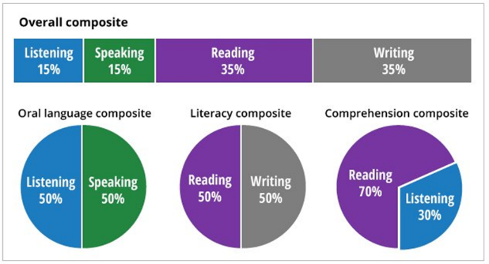
2027 WIDA ACCESS scores
Staying the same
Scale scores are reported on a 100-600 scale.
Proficiency levels (PLs) are reported from 1.0-6.0.
The composite score weights are the same (reminder: the weights use percentages of composite scale scores, not percentages of PLs).​
New in 2027
Proficiency levels are determined based on the new cut scores.

Slide 12
About the WIDA Proficiency Level Descriptors (PLDs)
Illustrate a continuum of language development for multilingual learners across six levels of English language proficiency for each grade-level cluster.
  Grade-level clusters: K, 1, 2-3, 4-5, 6-8, 9-12
Span three dimensions of language: discourse, sentence, and word/phrase.
Each proficiency level (PL) includes and builds on previous levels (e.g., PL4 = PL1 + PL2 + PL3 + PL4). PL6 is open-ended. It indicates that for all of us, language development continues throughout life.

Slide 13
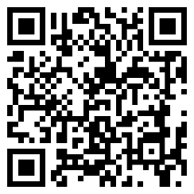
Want to learn more about the WIDA Proficiency Level Descriptors?
Explore pages 31-34 in the WIDA ELD Standards Framework book!
wida.wisc.edu/teach/standards/eld

Slide 14
About WIDA ACCESS Standard Setting 2026​

Slide 15
What is standard setting?
When a group of educator panelists recommend cut scores for an assessment.
Cut scores determine what separates one proficiency level from another in each language domain.
For example: What level of performance does a student need to achieve to receive a proficiency level of 3 versus 2 at their grade level?

Slide 16
Why did we conduct a standard setting?
We revised WIDA ACCESS (K-12) to be based on the WIDA ELD Standards Framework, 2020 Edition. This included
Publishing a brand-new WIDA ACCESS for Kindergarten with new scoring rubrics
Representing Standard 1 (Language for Social and Instructional Purposes) throughout the test
Releasing an updated Speaking Scoring Rubric
Publishing a new Writing Scoring Rubric

Slide 17
About the event
July 27-31, 2026, in Boston, Massachusetts
112 educator panelists participated, representing 37 consortium members. Panelists were assigned to one of 13 breakout groups, based on grade-level cluster.
36 state education agency (SEA) representatives participated as observers.
3 members of WIDA’s Technical Advisory Committee (TAC) were present to observe.

Slide 18
WIDA ACCESS Standard Setting methodology
There are multiple methods that can be used for standard setting. WIDA used two different methods:
Student-centered methods that focus on judgments about student performance. We used this approach, referred to as Modified Body of Work, for Speaking and Writing.
  Student portfolios formed the backbone of the Body of Work method.
  A “portfolio” is the collection of student responses.
  Student portfolios from the 2025-2026 WIDA ACCESS administration were selected purposefully to be illustrative examples of student work at that raw score level (e.g., attempted, adequate, strong).
Test-centered methods that focus on judgements about test item performance based on representative students. We used this approach, referred to as Modified Bookmark, for Listening and Reading.
  Representative test items were selected and put into “booklets” in order of lowest proficiency to highest, based on consortium-wide performance.

Slide 19
About the methodology
Using the Body of Work method, panelists
  Discussed the English-language skills expected of students in each proficiency level in the grade-level cluster panelists were assigned.
  Learned how actual students responded to test questions.
  Recommended cut scores by categorizing portfolios of student work.
Using the Bookmark method, panelists
  Discussed the English-language skills expected of students in each proficiency level in the grade-level cluster panelists were assigned.
  Studied the English language proficiency measured by test items.
  Recommended cut scores by determining which test items can generally be answered correctly by students at the threshold of each proficiency level.

Slide 20
Laying the groundwork
Breakout groups were assigned to either the Body of Work method or the Bookmark method. (One group used both methods and focused on all four domains for kindergarten.)
Panelists used the WIDA Proficiency Level Descriptors and their expertise with their assigned grade level(s) to create hypothetical students at each proficiency level “threshold” (e.g., moving from PL 2 to PL 3).
Throughout the event, panelists continuously referred to these “threshold descriptors” as they made decisions.

Slide 21
Creating threshold descriptors
During standard setting, panelists considered the proficiency expectations (from the PLDs) of each “threshold” student.
A threshold student is a hypothetical student whose performance is at the edge between two proficiency levels.
For example, a student who can demonstrate proficiency as specified in level 1 and has not shown evidence of demonstrating proficiency at level 2.
Panelists used the threshold descriptors to identify
(For Speaking and Writing) What proficiency level is the student response based on what panelists said each threshold student could do with expressive language?
(For Listening and Reading) Whether students at each threshold descriptor could generally answer a specific question. For example, could a student at this threshold correctly answer the question more often than not?

Slide 22
Determining recommended cut scores
The proficiency level cut score is the minimum scale score a student needs to achieve to score at a given proficiency level: the minimum score to reach PL2, PL3, etc., in their grade level.
Remember: Scale scores range from 100-600 and allow you to compare students across years. Proficiency levels are grade-level interpretations of scale scores.
Panelists used the standard setting methodologies and their threshold descriptors to identify the proficiency level cut scores for each level, in each domain, in grades K-12.

Slide 23
Standard setting daily agenda
Day 1
Day 2
Day 3
Day 4
  General session
  Standard Setting tool training
  Breakout Group Activity
  Practice & Round 1 (1-12 Listening, Speaking; Kindergarten Listening, Reading)
  Round 2
  (1-12 Listening, Speaking; Kindergarten Listening, Reading
  Round 3 Group Discussion
  Practice & Round 1 (1-12 Reading, Writing; Kindergarten Speaking, Writing)
  Round 2
  (1-12 Reading, Writing; Kindergarten Speaking, Writing)
  Round 3 Group Discussion
  Final reviews of cut scores
  Closing remarks

Slide 24
Educator panelist quote #1
What an educator panelist said…
I gained valuable insight into how multilingual learners demonstrate comprehension of spoken and written academic language and how assessment data is used to set fair and meaningful expectations. This experience will strengthen my ability to interpret ACCESS results and support educators in meeting the language development needs of multilingual learners.
- Ingrid Carias, FL

Slide 25
Educator panelist quote #2
What another educator panelist said…
I want educators to know that standard setting is a thoughtful and rigorous process. It is not simply choosing a number or looking at a score. Educators carefully examine student language, discuss evidence, and use their professional experience to make important decisions. Our voices matter because we work with multilingual learners every day.
- Autumn Pabst, MI

Slide 26
How does standard setting affect our school/district?

Slide 27
About the standard setting results
The new proficiency level cut scores demonstrate what students can do across proficiency levels.
When you receive a student’s 2027 WIDA ACCESS Individual Student Report, you may notice differences between their reported proficiency levels and what you and their other teachers expect.
  Because WIDA ACCESS tells you about a student’s abilities at one point in time, many factors can potentially impact their scores.
The new proficiency level cut scores may affect each state, territory, or federal agency a little differently. Because of this, your state education agency (SEA) is conducting its own data analysis. During this process, your SEA may decide to
  Revisit how accountability and growth are calculated.
  Reexamine your English learner reclassification criteria.

Slide 28
Reviewing 2027 WIDA ACCESS score reports
Use a student’s scale scores – reported on a vertical scale from 100-600 – to measure whether students made progress from 2025-2026 to 2026-2027. (Remember: Proficiency levels are a grade-level interpretation of these scale scores.)
Treat WIDA ACCESS scores as one of many pieces of information that can inform decisions you make about student supports. The new proficiency level cut scores may affect student scores differently depending on domain and grade level.
Use the proficiency level descriptors on the Individual Student Report to identify what the scores indicate students can do. Compare those descriptors with schoolwork, in-class assessments, and educator insights to create a complete picture of each student’s English language development.

Slide 29
Learn more about WIDA ACCESS Standard Setting

Slide 30
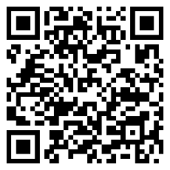
Visit the standard setting webpage
Learn about WIDA ACCESS Standard Setting
What happened
How it impacts
WIDA ACCESS in 2026-2027
Explore the webpage
wida.wisc.edu/standardsetting

