Slide 1
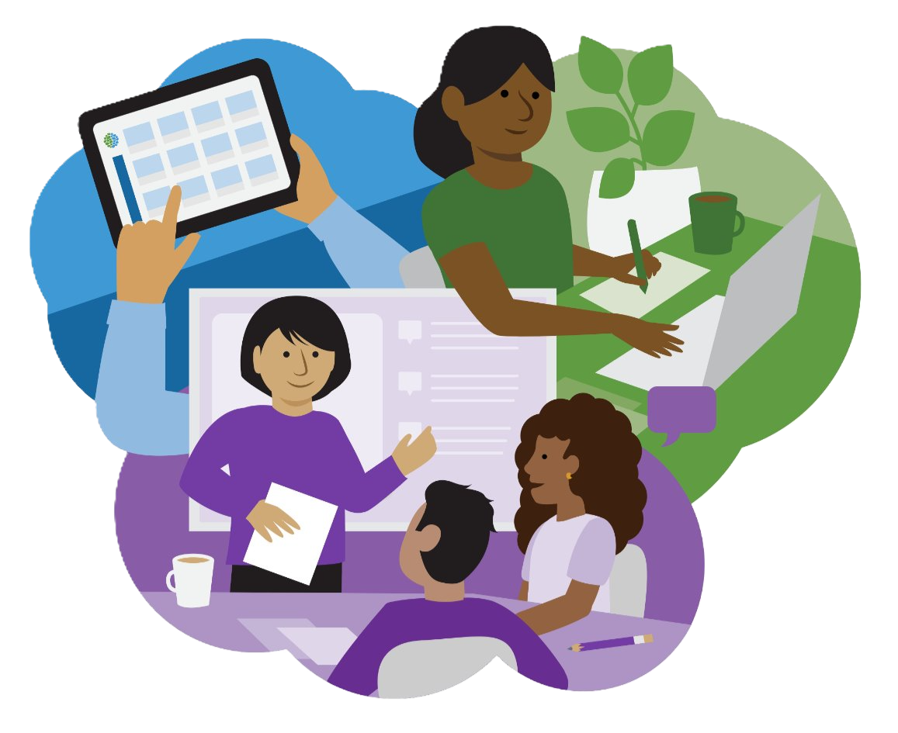
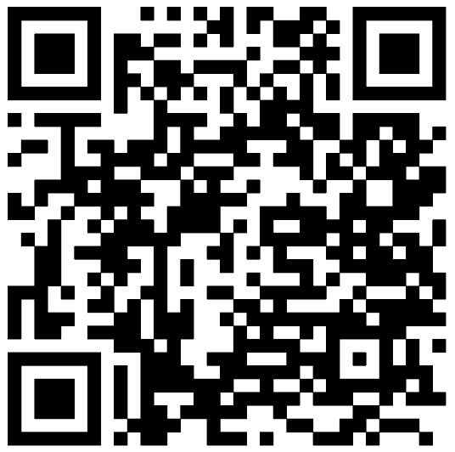
WIDA Core Learning Collection 2026-2027
All educators in the WIDA Consortium have access to the Self-Paced Workshops, On-Demand Videos and resources in the Core Learning Collection.
This collection features flexible, high-quality professional learning designed to support multilingual learners across all grade levels and content areas.
Relevant content for you and your colleagues:
ESL Teachers and Specialists
School Leaders
Professional Learning Communities
Bilingual Educators
PreK-12 Classroom Teachers
Coaches and Facilitators
Log in to your WIDA Secure Portal account to get started!
Explore all learning options at
wida.wisc.edu/grow/core-learning-collection
or scan the QR code to get started today!
Don’t have an account yet?
Visit your Member/State page
to learn how.

Slide 2
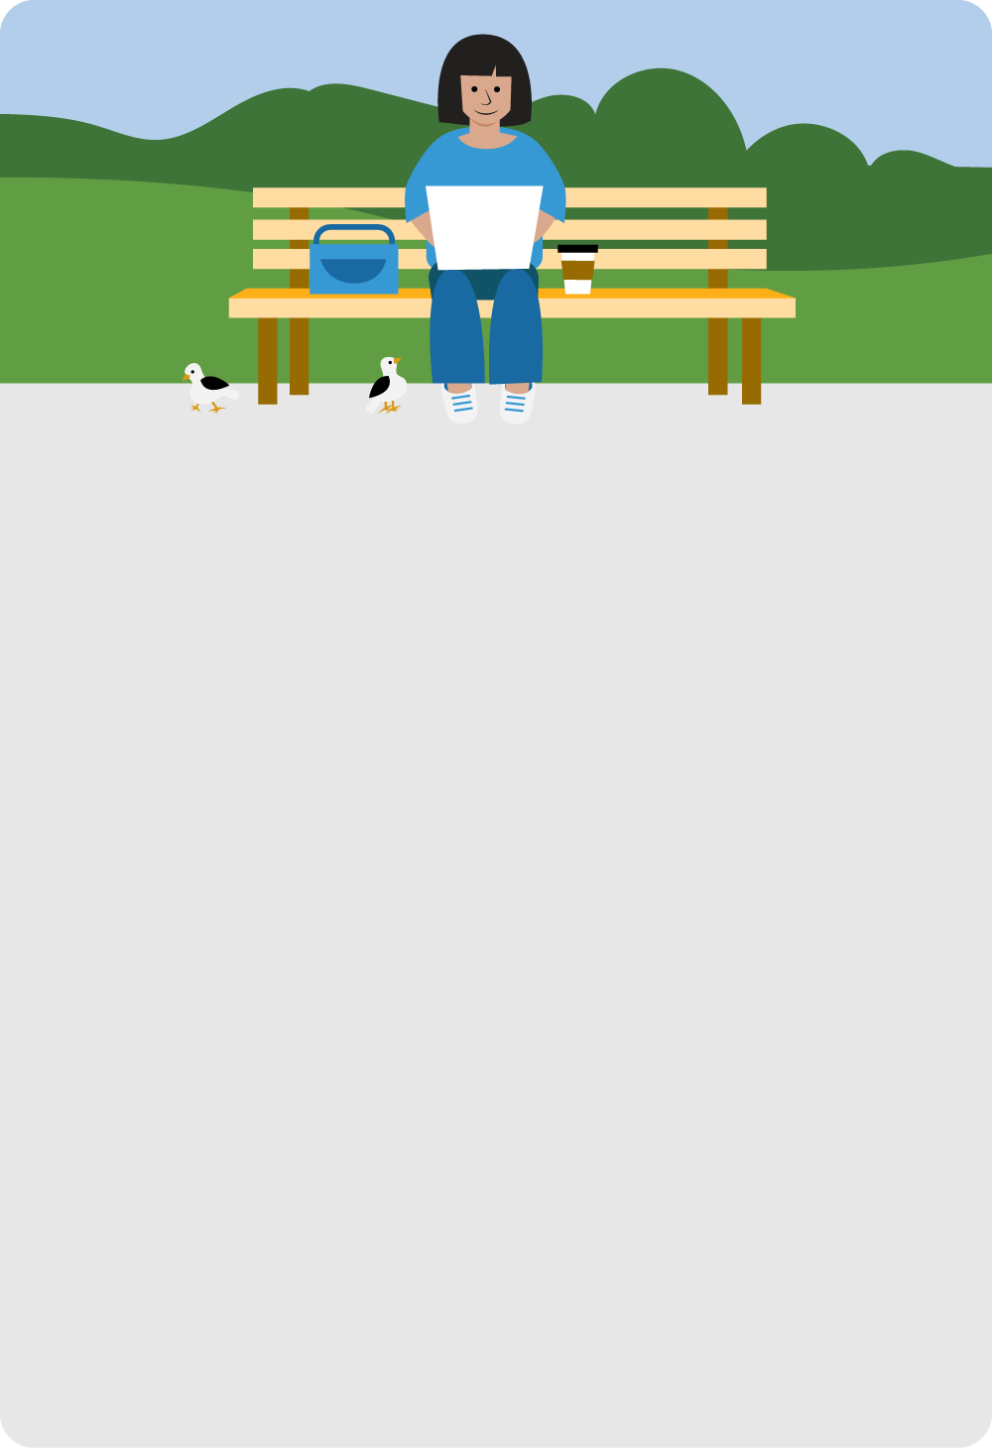
WIDA Self-Paced Workshops
2026-2027
Desarrollando el español: Las expectativas del lenguaje
Developing Language for Learning in Mathematics
Engaging Multilingual Learners in Science: Making Sense of Phenomena
Evaluaciones del desarrollo del lenguaje a nivel de salón: Classroom Assessment for Language Development
Exploring the WIDA PreK-3 Essential Actions
Let’s Play! Multilingual Children’s Joyful Learning in PreK-3
Making Language Visible in the Classroom
Newcomers Promoting Success Through Strengthening Practice
Reading Comprehension Across Content Areas With Multilingual Learners
Reframing Education for Long-term English Learners
Supporting Multilingual Learners With Disabilities in Language and Communication
Teaching Multilingual Learners Social Studies Through Multiple Perspectives
WIDA ELD Standards Framework: A Collaborative Approach
Relevant content for you and your colleagues:
ESL Teachers and Specialists
School Leaders
Professional Learning Communities
Bilingual Educators
PreK-12 Classroom Teachers
Coaches and Facilitators
Log in to your WIDA Secure Portal account to get started!

Slide 3
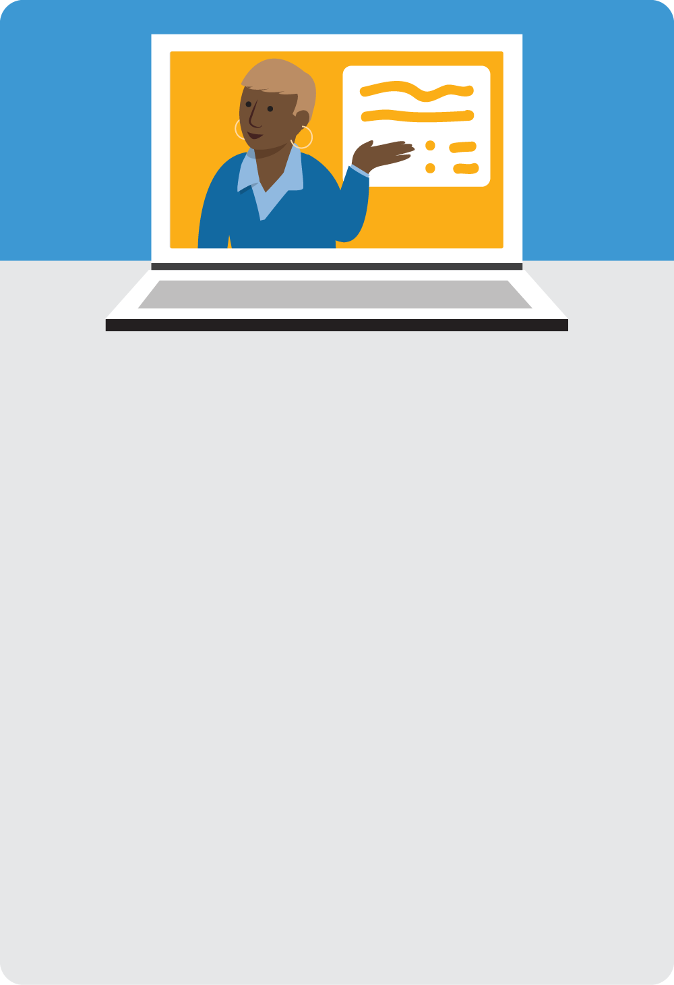
WIDA On-Demand Videos
2026-2027
WIDA Standards Frameworks
Introduction to the Marco DALE
Introduction to the WIDA English Language Development Standards Framework
WIDA Standards Frameworks for Bilingual Educators
Supplemental WIDA Assessment
Exploring WIDA ACCESS for Kindergarten
Exploring WIDA ACCESS Online 1–12
Understanding WIDA Alternate ACCESS Score Reports
Understanding WIDA ACCESS Score Reports for Instruction
Relevant content for you and your colleagues:
ESL Teachers and Specialists
School Leaders
Professional Learning Communities
Bilingual Educators
PreK-12 Classroom Teachers
Coaches and Facilitators
Log in to your WIDA Secure Portal account to get started!

